Slide 1
Fine Motor Skills in Early Childhood: A Guide for Parents of Preschool and Reception Children
Supporting young children's hand coordination development effectively
Notes:
---

Slide 2
Understanding Motor Skills and Fine Motor Skills
Notes:
Definition of Gross Motor Skills Vs. Fine Motor Skills, Examples of Gross Motor and Fine Motor Activities, Why Distinguishing Between the Two Is Important

Slide 3
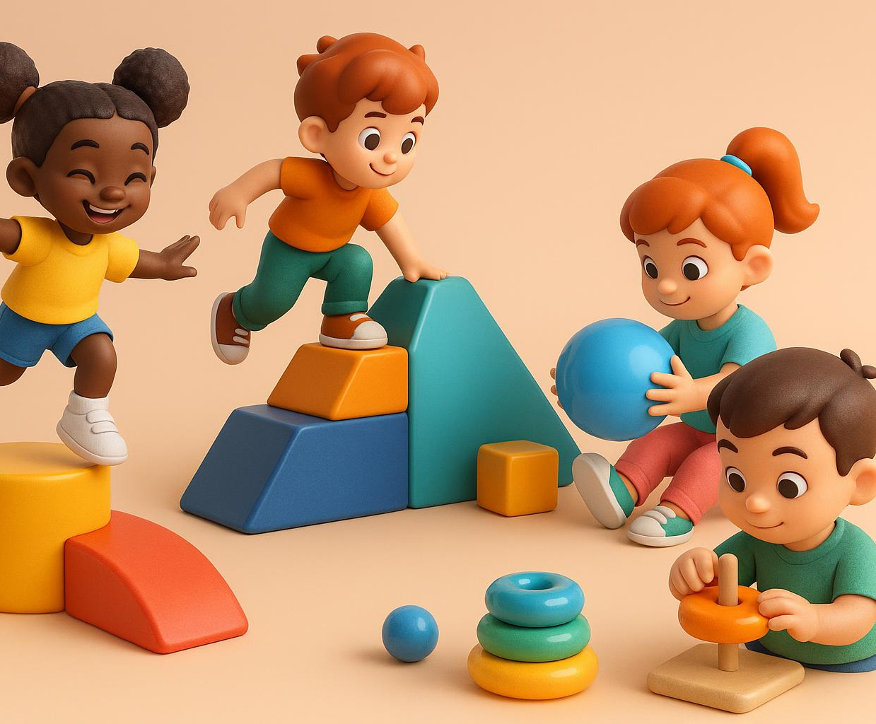
Definition of Gross Motor Skills Vs. Fine Motor Skills
Gross Motor Skills
  Gross motor skills involve large muscle groups for walking, running, jumping, and balance activities.
Fine Motor Skills
  Fine motor skills require coordinated use of small muscles in hands for grasping and tool manipulation.
Importance in Development
  Fine motor skills are essential for school readiness, supporting hand-eye coordination and cognitive growth.
Notes:
---
Gross motor skills involve the large muscles used for activities such as walking, running, jumping, and maintaining balance. Fine motor skills, in contrast, require the coordinated use of smaller muscles, particularly in the fingers and hands, enabling precise movements such as grasping objects, drawing, and manipulating tools. Research indicates that fine motor development is critical for school readiness, with skills like hand-eye coordination and dexterity developing alongside cognitive and social milestones during early childhood.
Image source: AI-generated

Slide 4
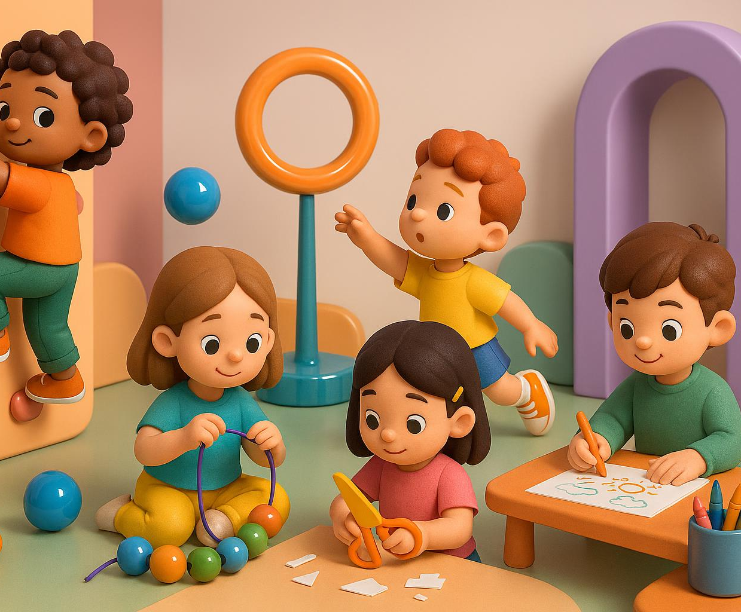
Examples of Gross Motor and Fine Motor Activities
Gross Motor Activities
  Gross motor activities like climbing and riding tricycles build muscle strength and improve coordination in preschoolers.
Fine Motor Activities
  Fine motor tasks such as threading beads and using scissors develop precision, control, and hand dexterity.
Benefits of Fine Motor Skills
  Regular engagement in fine motor activities enhances writing readiness and hand dexterity by reception age.
Notes:
---
Typical gross motor activities for preschoolers include climbing, throwing, and riding tricycles, fostering muscle strength and coordination. Fine motor examples include threading beads, using scissors, and drawing shapes, which enhance precision and control. Studies show children who engage regularly in diverse fine motor activities exhibit better hand dexterity and improved writing readiness by reception age.
Image source: AI-generated

Slide 5
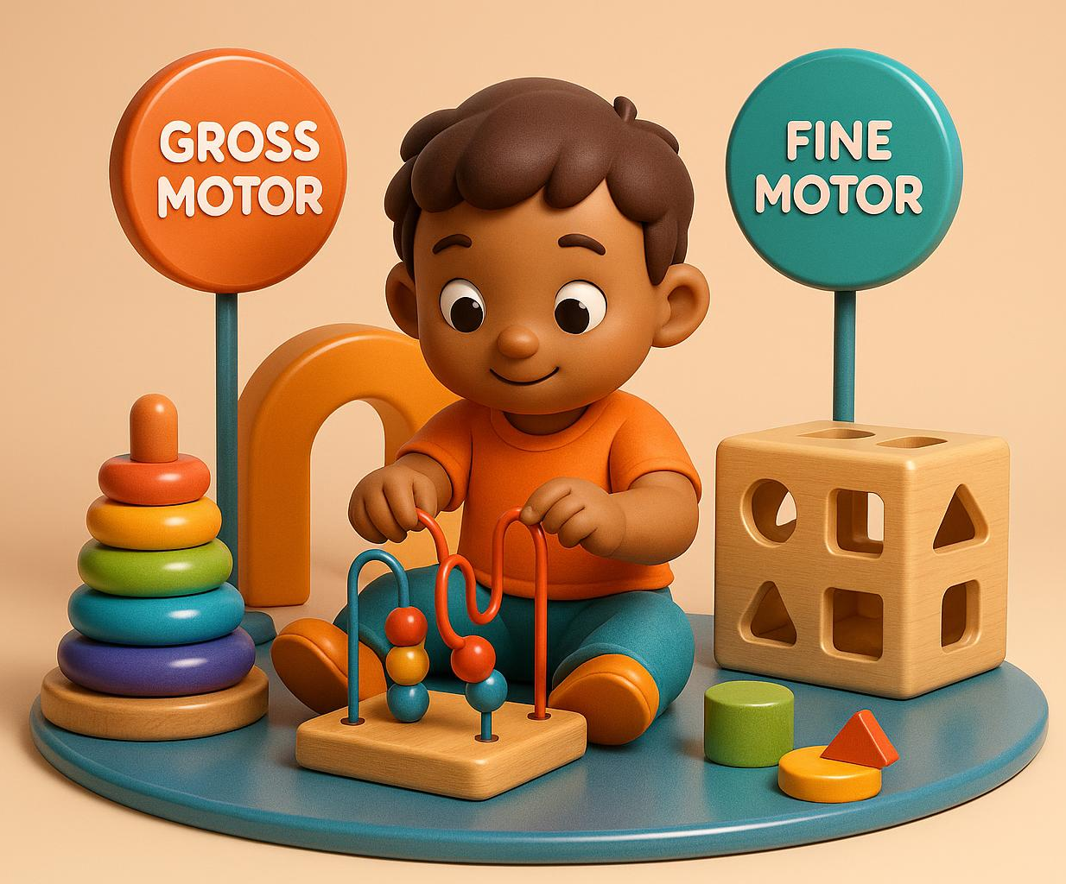
Why Distinguishing Between the Two Is Important
Gross Motor Skills Importance
  Gross motor skills support physical health and mobility essential for everyday activities and overall development.
Fine Motor Skills Role
  Fine motor skills are critical for academic tasks like writing, drawing, and manipulating small objects effectively.
Early Identification Benefits
  Early detection of motor delays enables timely interventions that improve educational and social outcomes.
Notes:
---
Understanding the distinction allows parents and educators to tailor developmental support appropriately; gross motor skills underpin physical health and mobility, while fine motor skills are foundational to academic tasks such as writing and arts. Research emphasizes early identification of delays in either domain ensures timely interventions, facilitating better long-term educational and social outcomes.
Image source: AI-generated

Slide 6
Real-Life Applications of Fine Motor Skills
Notes:
Self-Care Tasks: Buttoning, Zipping, Feeding, Play and Learning: Building Blocks, Crafts, Drawing, Early Writing and Classroom Participation

Slide 7
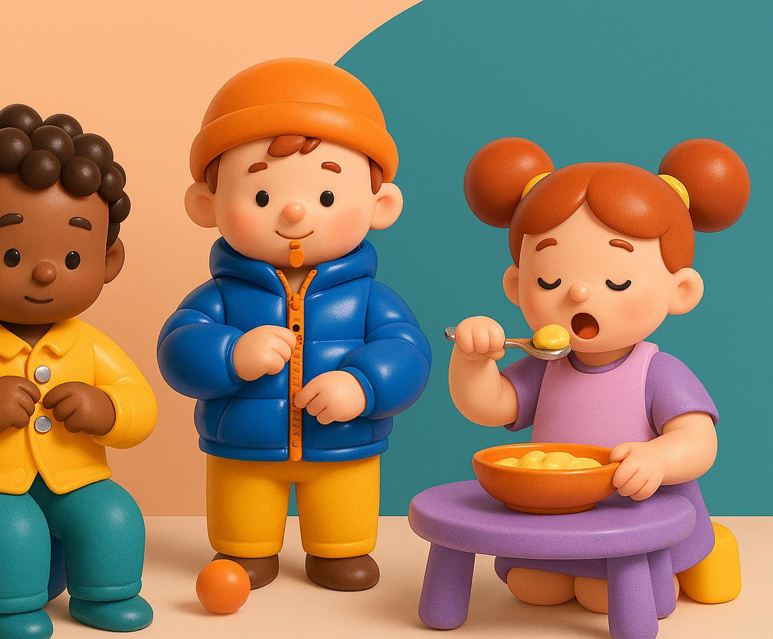
Self-Care Tasks: Buttoning, Zipping, Feeding
Fine Motor Skills Importance
  Fine motor skills are essential for children to perform daily self-care tasks independently and confidently.
Self-Care Task Examples
  Tasks like buttoning shirts, zipping jackets, and feeding with utensils help develop children's autonomy in daily routines.
Early Development Benefits
  Early mastery of fine motor skills correlates with greater independence by age five and reduces adult assistance.
Notes:
---
Fine motor skills enable children to perform self-care tasks such as buttoning shirts, zipping jackets, and using utensils for feeding independently. Mastery of these skills boosts children's confidence and reduces reliance on adults. Studies suggest children who develop fine motor competence early are more likely to achieve autonomy in daily routines by age 5.
Image source: AI-generated

Slide 8
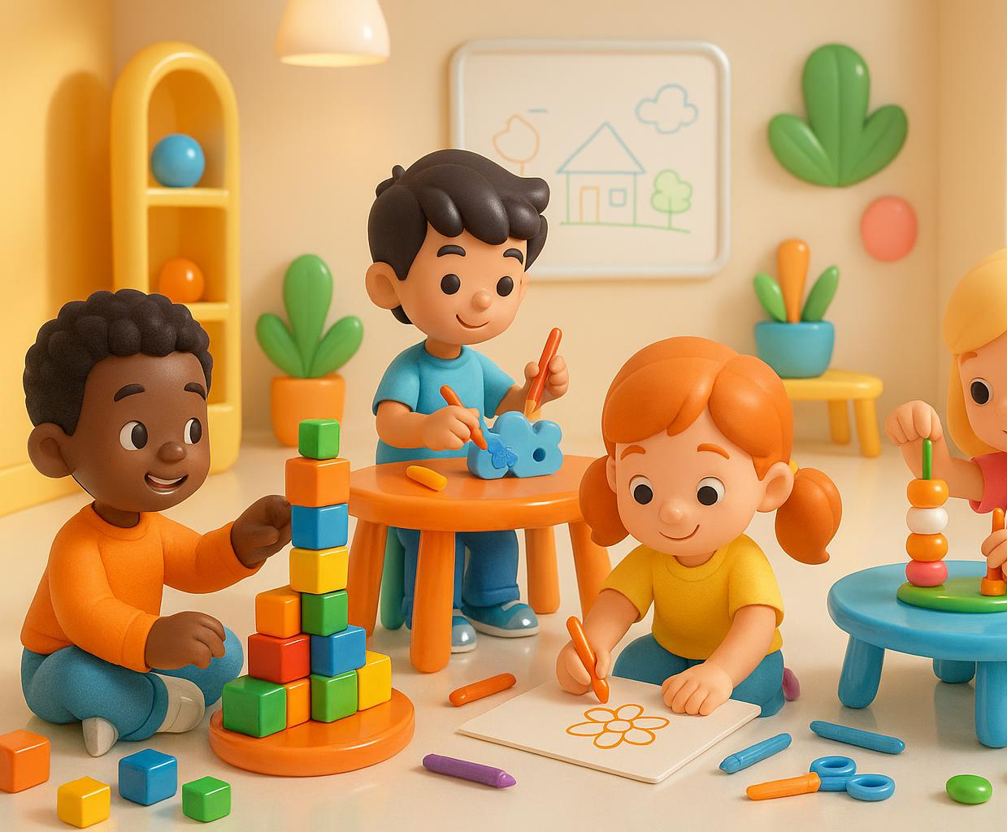
Play and Learning: Building Blocks, Crafts, Drawing
Enhancing Motor Skills
  Playing with blocks, crafts, and drawing strengthens hands and improves finger dexterity for young learners.
Boosting Problem Solving
  These play activities encourage creativity and develop problem-solving abilities in preschool children.
Supporting Sensory Processing
  Tactile feedback from play promotes sensory integration critical for holistic learning development.
Notes:
---
Engagement in play activities such as stacking building blocks, crafting, and drawing enhances hand strength, finger dexterity, and visual-motor integration. Research links these activities to improved problem-solving skills and creativity, essential for holistic preschool learning development. The tactile feedback from such play also fosters sensory processing skills.
Image source: AI-generated

Slide 9
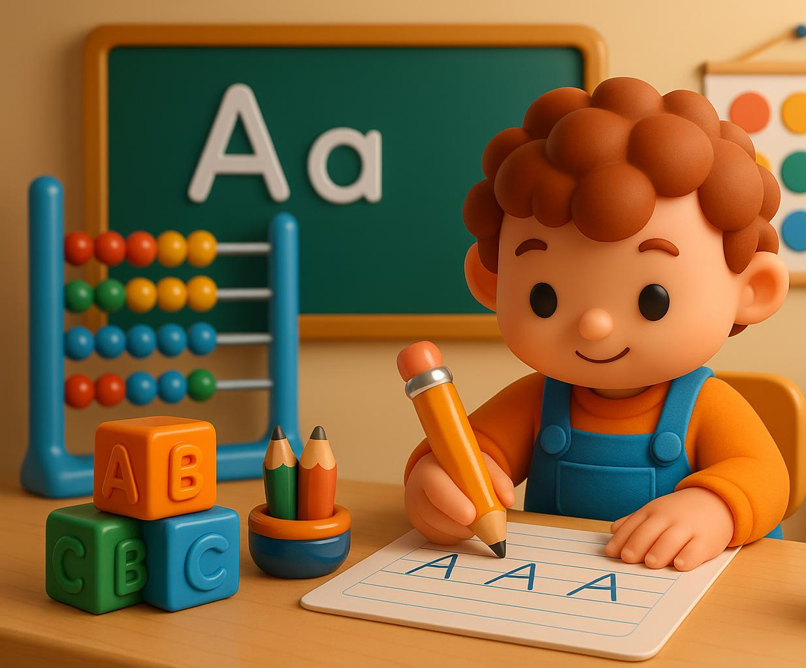
Early Writing and Classroom Participation
Fine Motor Proficiency Importance
  Fine motor skills enable children to hold pencils properly and control writing strokes effectively.
Impact on Classroom Tasks
  Good fine motor control improves performance in writing, coloring, and use of classroom educational tools.
Correlation with Literacy Achievement
  Research shows fine motor development in preschool positively correlates with early literacy success.
Notes:
---
Fine motor proficiency is crucial for early writing, enabling children to hold pencils correctly and control strokes. This translates to better performance in classroom tasks such as writing, coloring, and using educational tools. Educational research identifies a positive correlation between fine motor skill development in preschool and literacy achievement in early school years.
Image source: AI-generated

Slide 10
Fine Motor Skills in the EYFS Curriculum
Notes:
Overview of EYFS and Its Focus on Physical Development, Progression of Fine Motor Skills for Each EYFS Age Band, Key Learning Outcomes Related to Fine Motor Skills

Slide 11
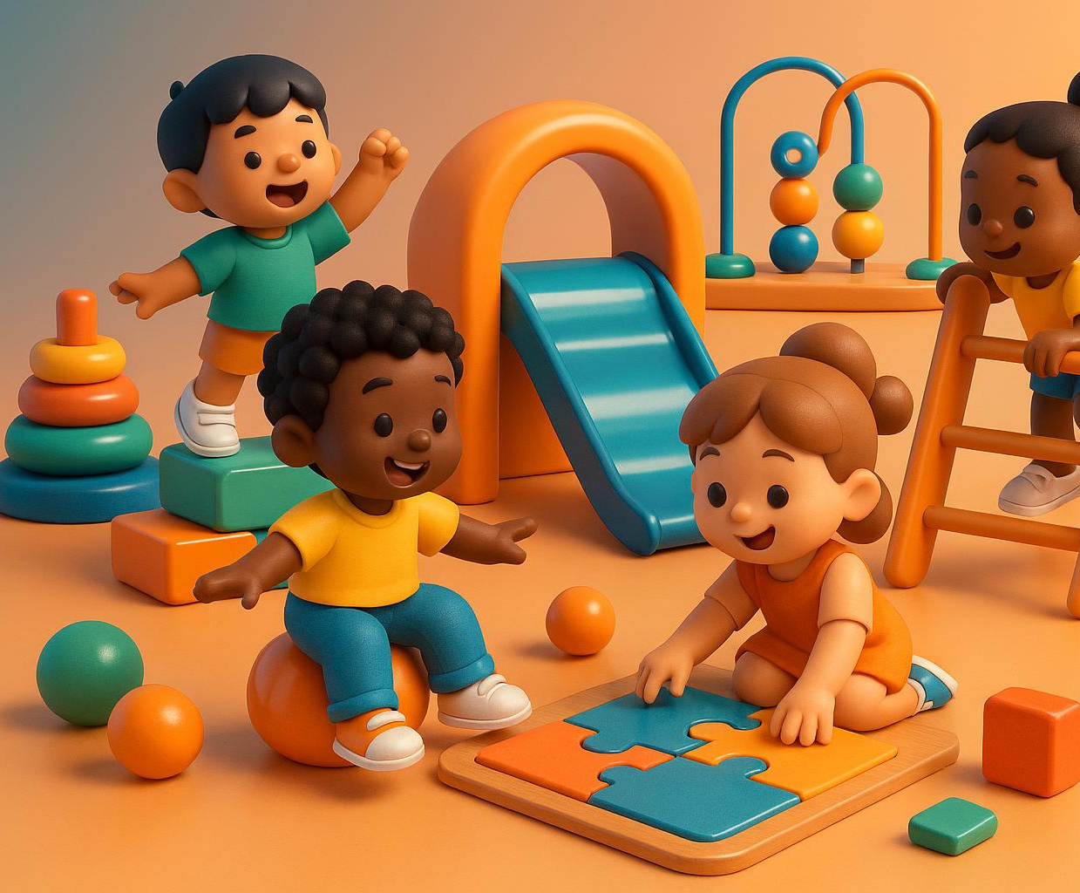
Overview of EYFS and Its Focus on Physical Development
Physical Development Emphasis
  EYFS prioritizes physical development as a key area essential for early childhood learning growth and development.
Coordination and Control
  EYFS supports improving children's coordination, control, and movement through engaging and age-appropriate exercises.
Readiness for School
  Targeted physical activities in EYFS enhance children's readiness for formal schooling and bolster cognitive development.
Notes:
---
The Early Years Foundation Stage (EYFS) curriculum emphasizes physical development as a prime area, highlighting the importance of motor skills in early learning. It aims to foster children's coordination, control, and movement through age-appropriate activities. Government reports show that targeted physical development within EYFS improves readiness for formal schooling and supports cognitive growth.
Image source: AI-generated

Slide 12
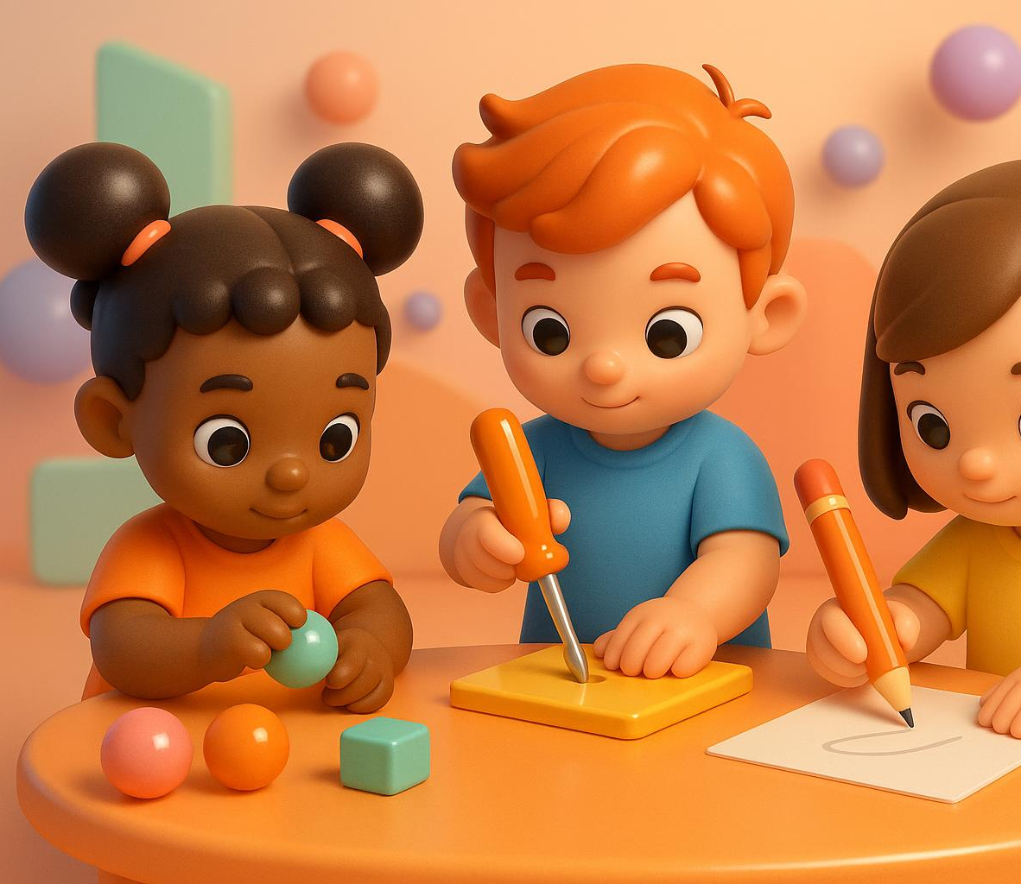
Progression of Fine Motor Skills for Each EYFS Age Band
Early Grasping Skills
  In the 0-2 years band, children develop simple grasping and hand-eye coordination essential for fine motor growth.
Using One-Handed Tools
  By ages 3-5, children begin using one-handed tools and develop control for more precise movements.
Early Writing Tasks
  Early writing tasks are introduced gradually, helping children improve dexterity and pencil control.
Milestone Tracking Importance
  Tracking fine motor milestones helps educators and parents provide support and identify developmental concerns early.
Notes:
---
EYFS outlines clear milestones for fine motor development, from simple grasping in the 0-2 years band to using one-handed tools and beginning early writing tasks by ages 3-5. This progression supports gradual skill acquisition with complex tasks introduced incrementally. Tracking these milestones assists educators and parents in providing appropriate support and identifying any developmental concerns early.
Image source: AI-generated

Slide 13
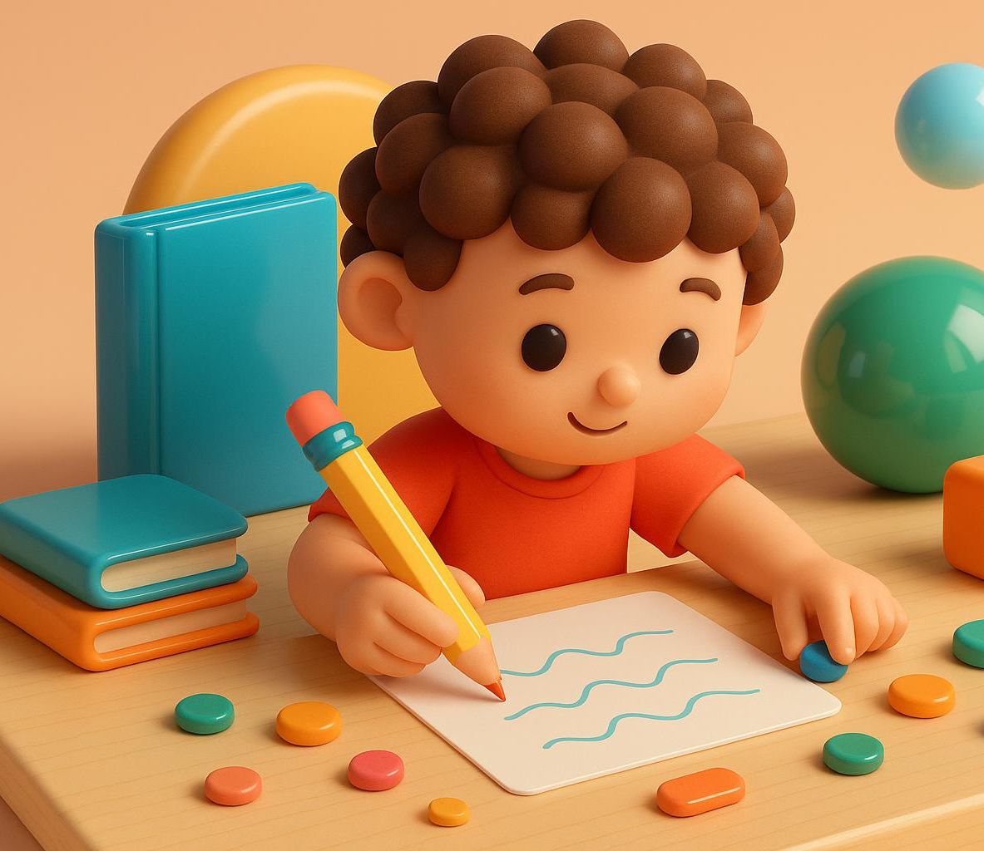
Key Learning Outcomes Related to Fine Motor Skills
Pencil Holding Skills
  Effective pencil holding is a foundational fine motor skill essential for writing and drawing accuracy in early education.
Manipulating Small Objects
  Control over small objects enhances hand-eye coordination and dexterity crucial for classroom tasks and daily activities.
Purposeful Mark-Making
  Engaging in intentional mark-making supports early literacy and numeracy skills development and creative expression.
Academic Readiness Impact
  Achieving fine motor milestones correlates with higher engagement and confidence in literacy and numeracy learning.
Notes:
---
Key fine motor learning outcomes include the ability to hold a pencil effectively, manipulate small objects with control, and engage in purposeful mark-making. Meeting these outcomes correlates strongly with improved literacy and numeracy readiness. Studies from the UK education sector reveal that children achieving these milestones show higher academic engagement and confidence during reception year.
Image source: AI-generated

Slide 14
Pen Grasp Types: Visual Guide
Notes:
Fisted Grasp (with Diagram), Digital Pronate and Four-Finger Grasp (with Diagrams), Tripod and Quadrupod Grasp (with Diagrams)

Slide 15
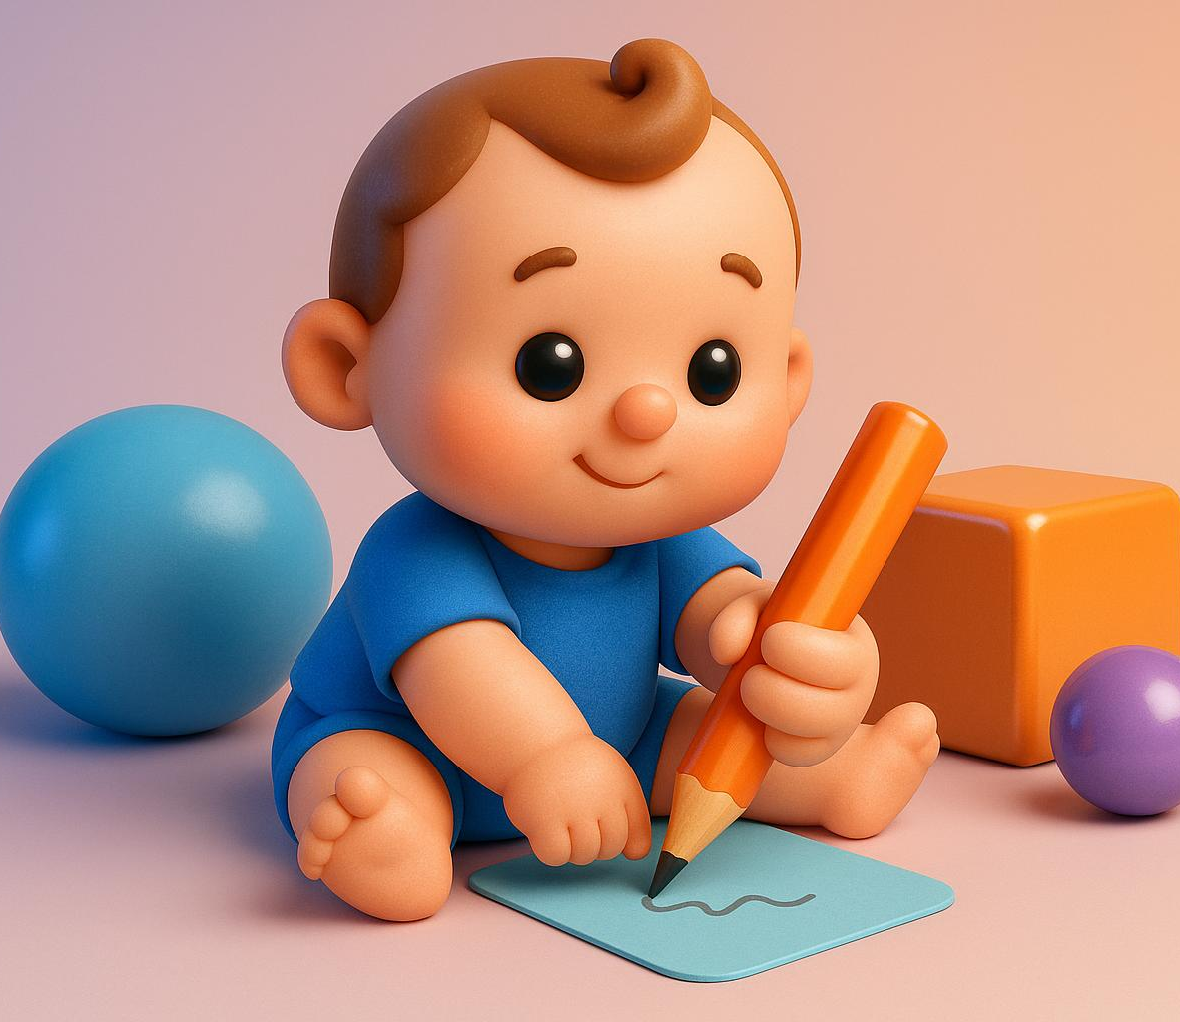
Fisted Grasp
Definition of Fisted Grasp
  The fisted grasp is an early reflexive grip where toddlers use the whole hand to hold objects like pencils.
Age Typical Pattern
  This grasp is common in children under 2 years and is a normal part of early motor skill development.
Developmental Significance
  The fisted grasp forms a foundation for later, more refined hand grips as motor skills mature.
Parental Guidance
  Visual illustrations help parents identify the fisted grasp as a normal developmental stage in toddlers.
Notes:
---
The fisted grasp is a reflexive and early developmental holding pattern where the child wraps fingers around the pencil, supporting it with the whole hand. This grip is typical in toddlers below 2 years and is foundational before progressing to more refined grasps. Illustrations help parents recognize this grasp and understand its normal place in development.
Image source: AI-generated

Slide 16
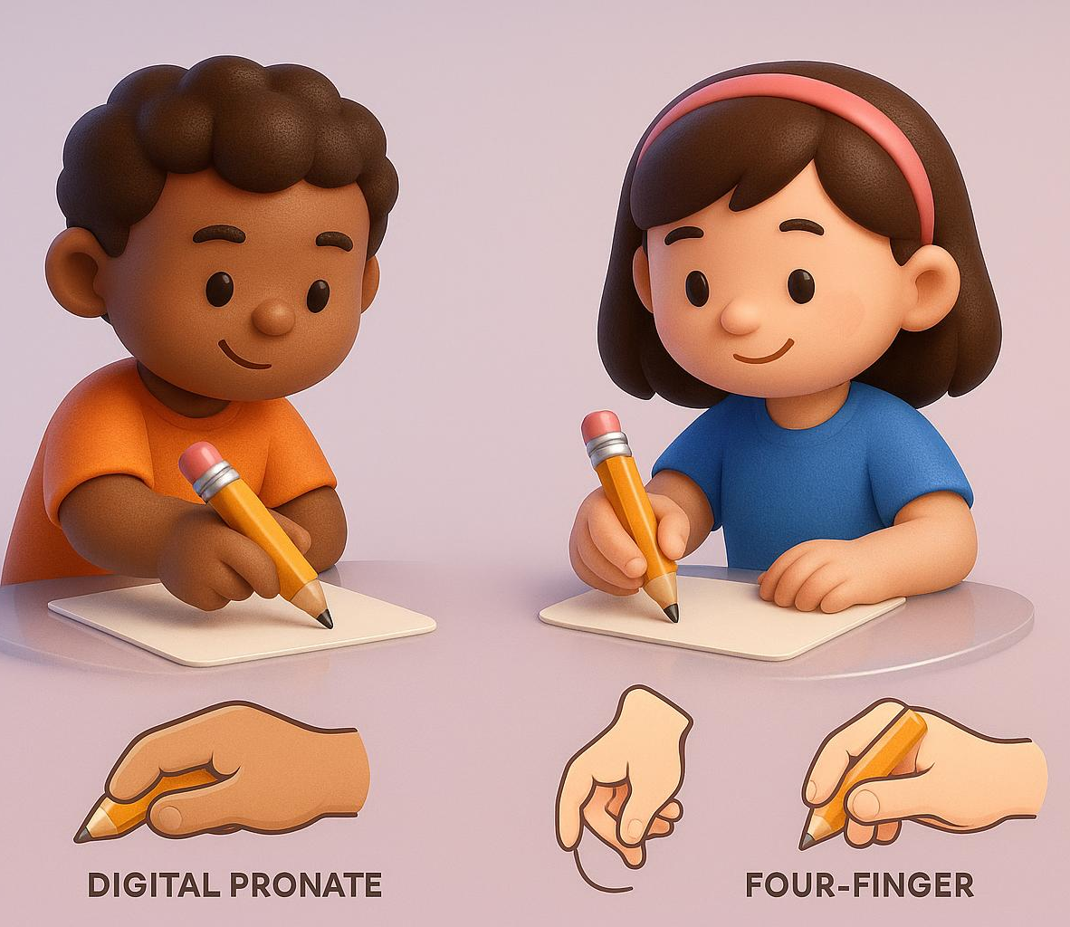
Digital Pronate and Four-Finger Grasp
Digital Pronate Grasp
  Fingers point downward with palm resting on the writing surface for basic pencil control in early preschool years.
Four-Finger Grasp
  Involves more finger engagement than digital pronate grasp, enhancing control and coordination during writing.
Developmental Significance
  These grasps are transitional stages indicating growing hand coordination in preschool children.
Visual Aids Importance
  Use of diagrams helps recognize grasps and supports progression to mature pencil grips.
Notes:
---
The digital pronate grasp involves holding the pencil with fingers pointing downward and palm resting on the writing surface. The four-finger grasp adds more finger involvement for increased control. These are transitional grasps typical in early preschool years and signify developing hand coordination. Visual diagrams greatly aid in recognizing and encouraging progression towards mature grips.
Image source: AI-generated

Slide 17
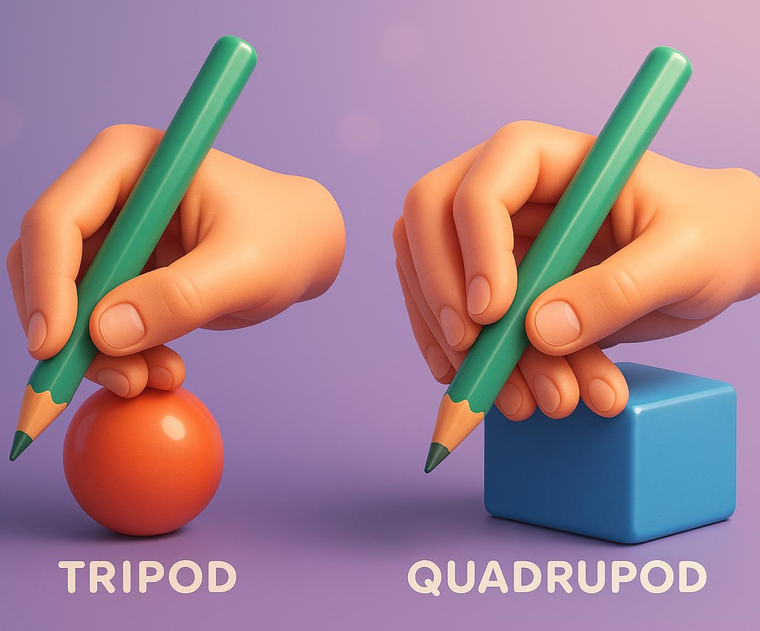
Tripod and Quadrupod Grasp
Tripod Grasp Definition
  The tripod grasp uses thumb, index, and middle fingers for mature pencil control and precision.
Quadrupod Grasp Definition
  The quadrupod grasp adds the ring finger for extra stability during writing tasks.
Importance for School Readiness
  Both grasps enable precise, sustained writing essential for reception-age children learning to write.
Notes:
---
The tripod grasp is the mature pencil hold using the thumb, index, and middle finger to control the writing tool, while the quadrupod includes the ring finger for added stability. These grasps enable precise and sustained writing efforts found in reception-age children progressing towards school readiness. Diagrams illustrate correct finger positioning, supporting parent coaching at home.
Image source: AI-generated

Slide 18
Fun Home Activities to Boost Fine Motor Skills
Notes:
Creative Play: Playdough, Threading, and Crafts, Practical Life Activities: Pouring, Tweezing, and Peeling, Games and Exercises: Puzzles, Pegboards, and Finger Rhymes

Slide 19
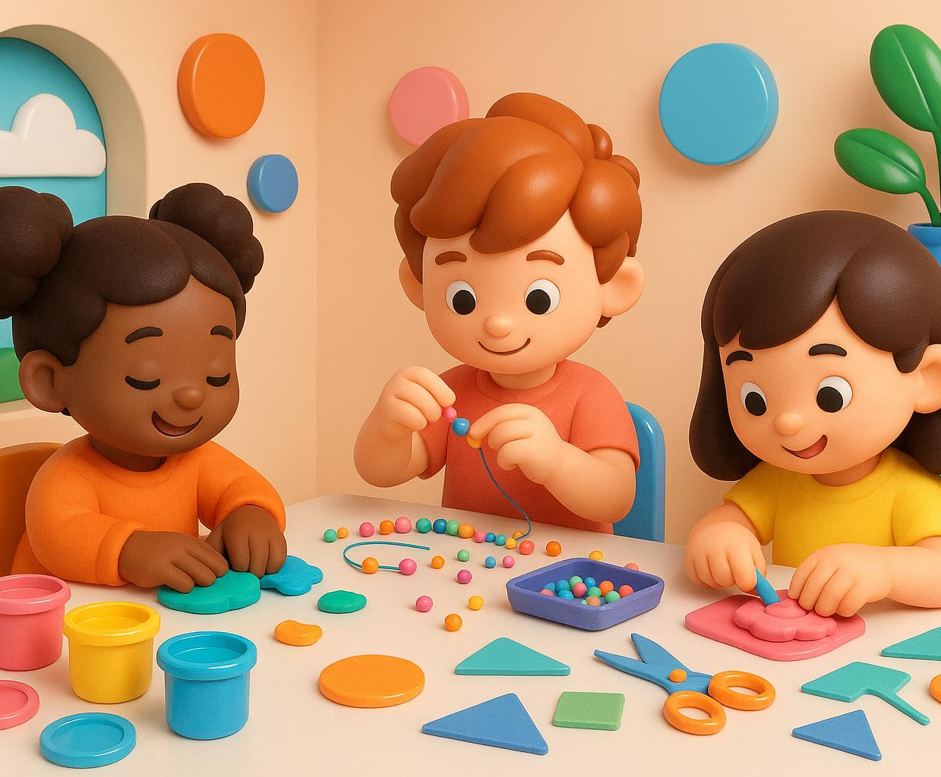
Creative Play: Playdough, Threading, and Crafts
Enhancing Finger Strength
  Molding playdough helps children build finger strength and improve hand muscles through tactile play.
Improving Coordination
  Threading beads develops hand-eye coordination and precision in fine motor control.
Stimulating Imagination
  Craft activities engage creativity and sensory processing while promoting bilateral hand use.
Notes:
---
Creative play activities like molding playdough, threading beads, and engaging in simple crafts enhance finger strength, coordination, and bilateral hand use. Evidence-based parenting guides recommend these activities as fun ways to boost fine motor skills while stimulating imagination and sensory processing.
Image source: AI-generated

Slide 20
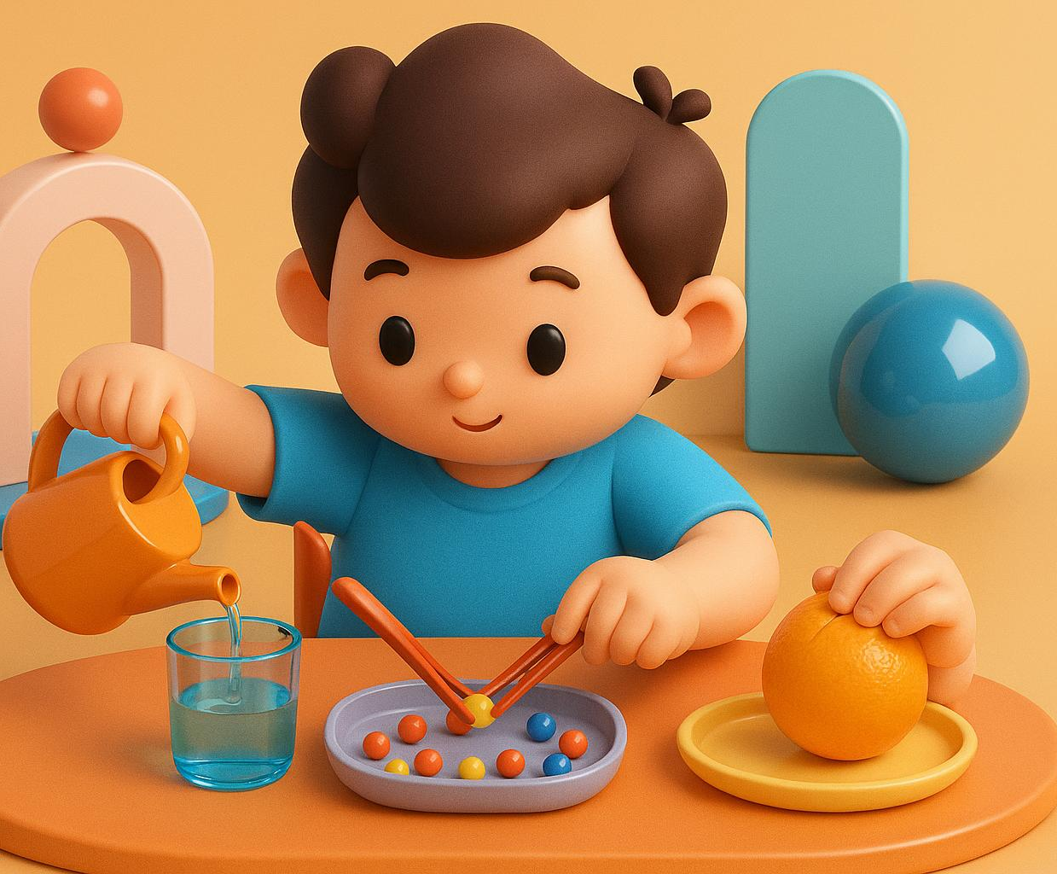
Practical Life Activities: Pouring, Tweezing, and Peeling
Pouring Liquids
  Pouring liquids helps children develop precision and coordination in hand and arm movements.
Tweezing Small Items
  Using tweezers to pick small objects enhances fine motor skills and hand control.
Peeling Fruit
  Peeling fruit encourages bilateral hand coordination and builds independence in practical tasks.
Notes:
---
Everyday life skills such as pouring liquids, using tweezers to pick small items, and peeling fruit build precision and control in hand movements. Montessori-inspired research highlights these practical tasks as critical for developing purposeful hand use and independence in young children.
Image source: AI-generated

Slide 21
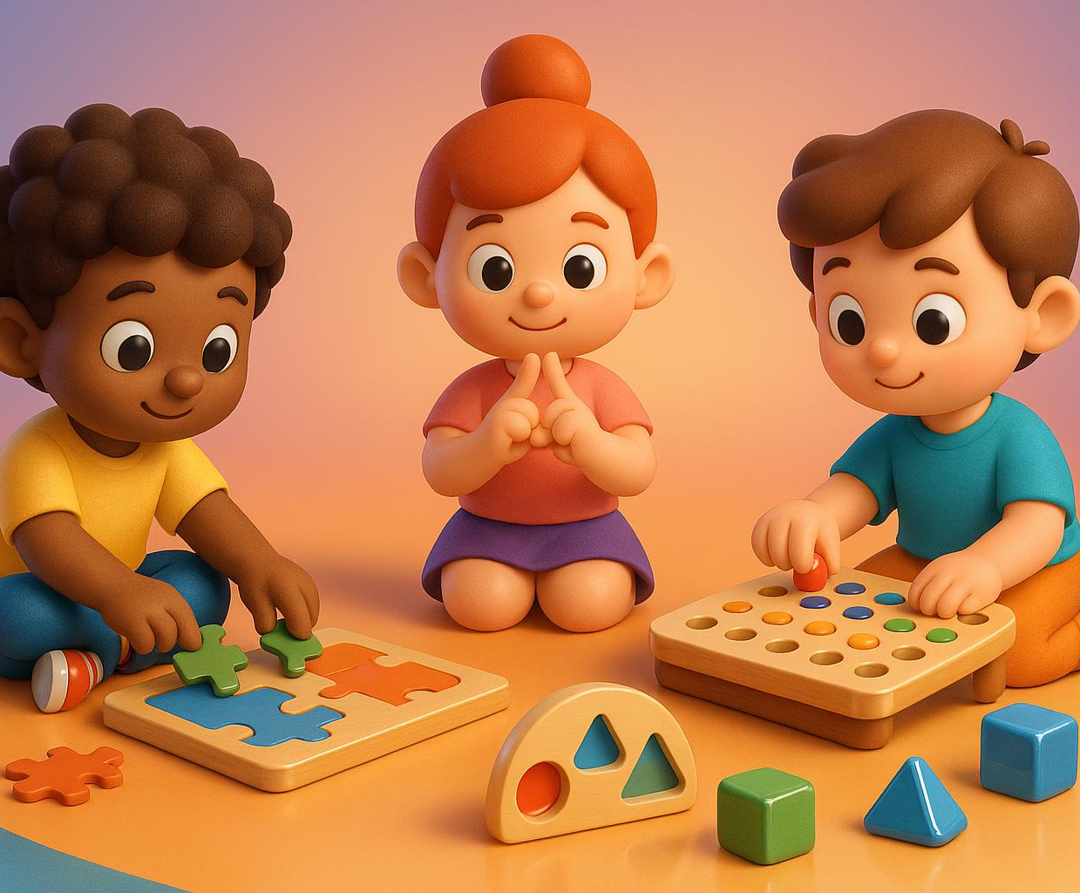
Games and Exercises: Puzzles, Pegboards, and Finger Rhymes
Fine Motor Coordination
  Puzzles and pegboards enhance children's fine motor coordination by encouraging precise hand and finger movements.
Finger Isolation and Rhythm
  Finger rhymes promote finger isolation and rhythmical hand movements essential for motor skill development.
Improved Attention and Dexterity
  These interactive games and exercises improve attention span and manual dexterity, aiding classroom readiness.
Notes:
---
Interactive games like puzzles, pegboards, and finger rhymes promote fine motor coordination, finger isolation, and rhythmical hand movement. Studies show these play-based exercises improve attention span and manual dexterity, supporting readiness for writing and other classroom tasks.
Image source: AI-generated

Slide 22
Conclusion: Empowering Early Childhood Development Through Fine Motor Skills
Gross vs Fine Motor Skills
Distinguishing gross from fine motor skills is essential for targeted child development support and early education approaches.
Importance in Daily Life
Fine motor skills influence daily tasks, play activities, and learning outcomes crucial for early childhood success.
Role of Parents and EYFS
Parents and EYFS curriculum play a vital role by recognizing pen grasp types and encouraging playful home activities.
Notes:
In summary, understanding the distinction between gross and fine motor skills is crucial for supporting young children. Fine motor skills impact daily tasks, play, and learning, all emphasized within the EYFS curriculum. By recognizing pen grasp types and incorporating fun home activities, parents can actively nurture their child's development and confidence during these formative years.

