Slide 1
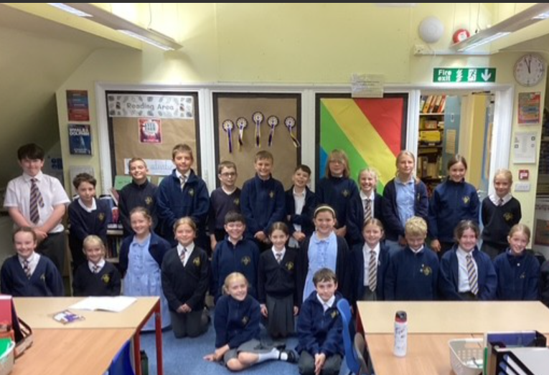
Meet The Teacher
Jupiter September 2026
September 2026

Slide 2
Staff In Class
Mrs Roberts teaches at the beginning of the week, handing over to Miss Kershaw after Wednesday break.
Mrs Mukadam works every day in Jupiter classroom.
Mrs Frampton works on a Wednesday and Thursday.
Mrs Clack works on a Tuesday and a Friday.
The diaries will be checked for messages three times a week – Monday, Wednesday and Friday.
If you would like to speak to a member of staff and you feel it is urgent, please do get in touch with the admin team who can pass on a message. If not, please speak to us at the end of the school day or email us. We will reply within three working days between the hours of 7:45am and 5:30pm.

Slide 3
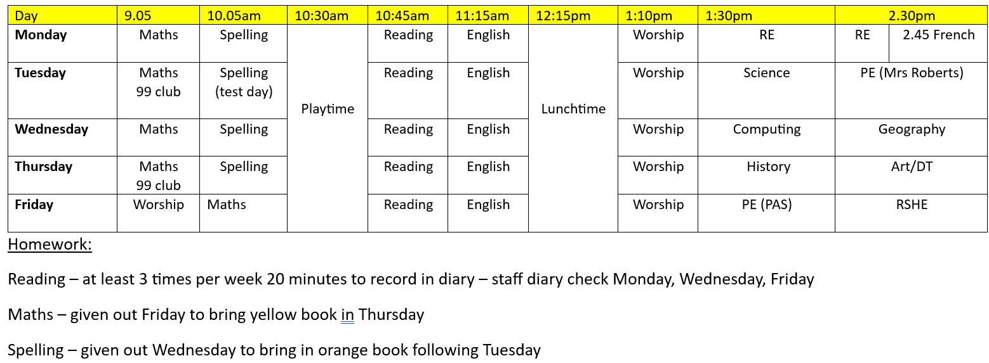
Timetable Autumn 2026

Slide 4
Daily Routine
To begin the day, the pupils identify which ‘zone’ they are in on our emotions check in.
Staff will use this language throughout learning and we encourage children to use this at home too: please ask your child to explain the four zones and help them identify what helps them move from one to another.
On Mondays, Wednesdays and Fridays, the staff will check and stamp your child’s diary. Please encourage your child to record in their diaries - we love to see their extra learning activities!
Movement breaks are scheduled so that pupils do not have to sit for long periods of time and this is also impacting positively on their learning.
Please see our long term plan attached for topics covered across the curriculum. It is also published on the website.

Slide 5
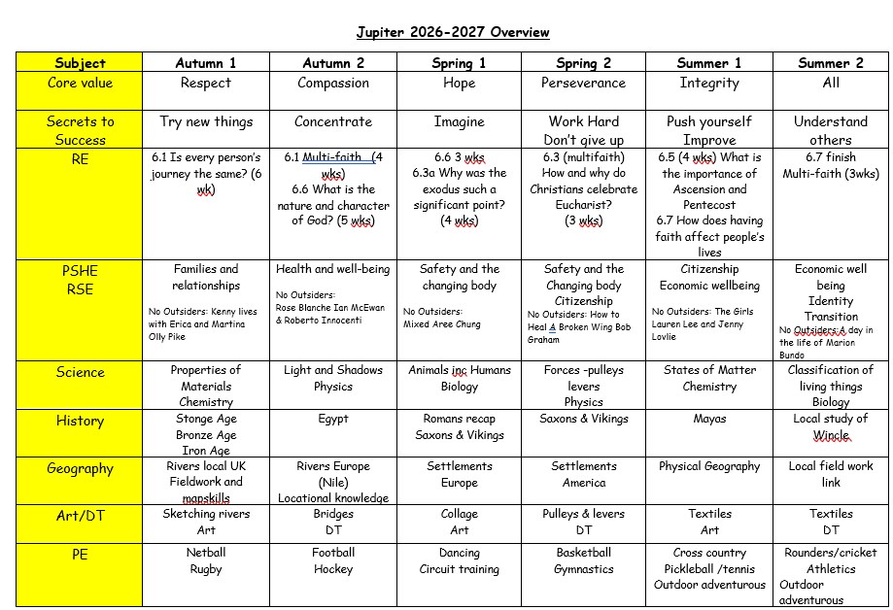
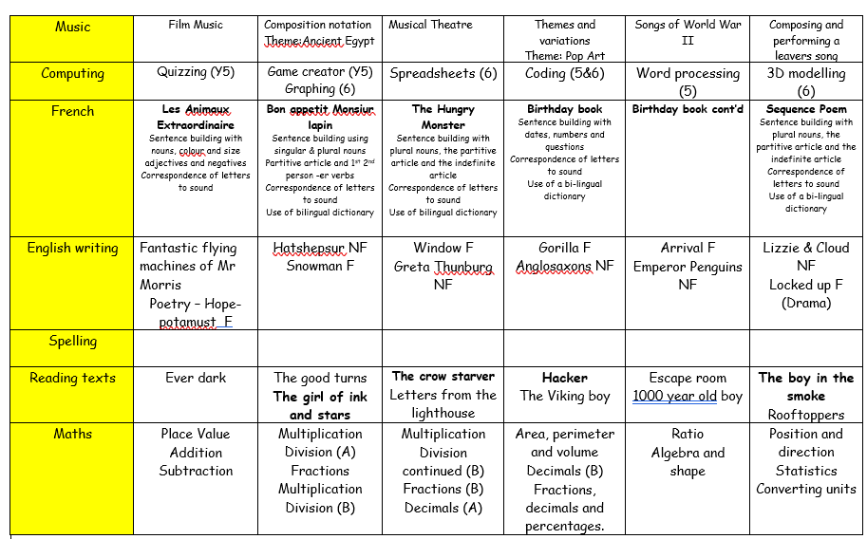
Jupiter Long Term Plan – 2026-27

Slide 6
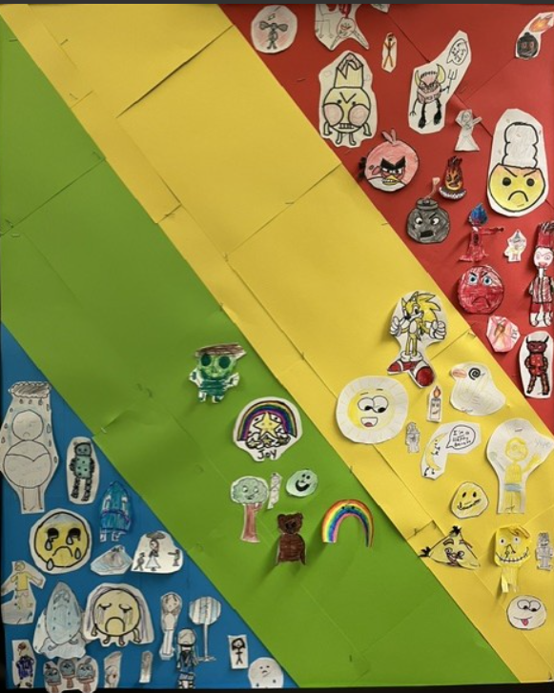
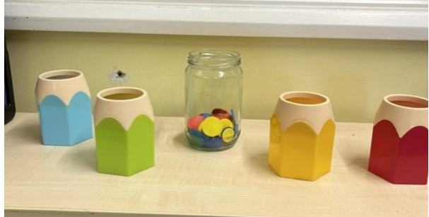
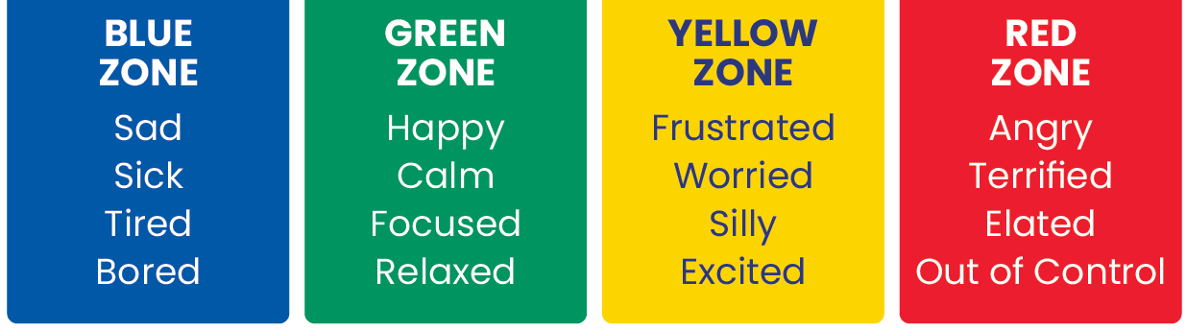
Zones of Regulation
Insert photo here of board

Slide 7
Rewards and Sanctions
‘Star of the Day’ daily class worship Monday – Thursday
based on following school values and vision.
Class dojo records the rewards daily and reset weekly
Homework dojos awarded – treat if 18 or more achieved half termly
Stickers and stamps are given to reward for hard
Certificates are awarded in Celebration Worship on a Friday- school
values, vision and School Games award values.

Slide 8
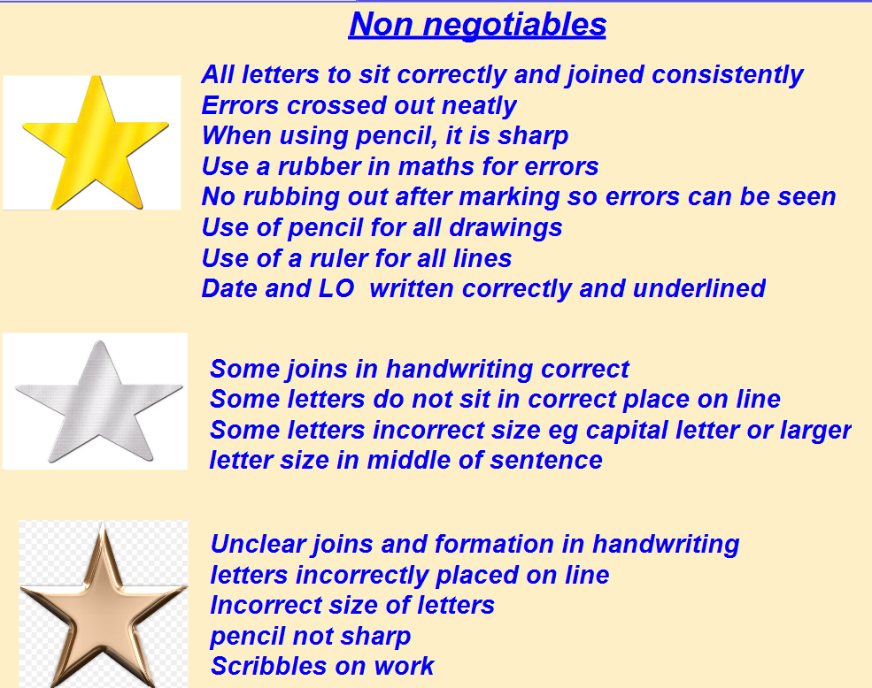
Non-negotiables – presentation star awards

Slide 9
The Card System
What is the point of the system?
To give a clear, consistent approach so children know exactly what is expected and what is going to happen.
What should each card achieve?
Yellow – to explain what we would like to see.
Orange – to give a warning.
Red- a consequence
Why do we not just say, “no”?
This is meaningless to most children.
Notes:
DLD is very common but very few people know what it is. Compared to other developmental difficulties it is much less well known. DLD is a broad term and children can have a range of difficulties.
The term DLD replaces the terms Specific Language Impairment (SLI) and language delay, which you may have heard before. As a department we follow the generally accepted guidance that DLD is not diagnosed before age 5, however we may indicate that we suspect a child has DLD prior to this if we have sufficient grounds.
It covers a wide range of difficulties and the children who have a DLD diagnosis are a very diverse group. Some may have other difficulties (such as LD, ASC), some may not. Some may have normal cognitive levels, some may not. Some may have difficulties that are very obvious, for some the difficulties may be quite well hidden or may present as something else (e.g. behaviour, reluctance, low confidence).
The profile of children with DLD is also unique – some children have no difficulties understanding but they cannot express their thoughts and ideas through language. For others both understanding and expressive language are affected. This will be outlines in the child’s report and/or communication profile.

Slide 10
The Card System
I am showing you a yellow card because you are…
Please do …. instead
Please do … or I will give you a red card.
I am showing you a red card because…
We will now…
We will write in a child’s diary if they receive a red card.

Slide 11
The Card System
I am showing you a yellow card because you are…
Please do …. instead
Yellow shouldn’t be a serious situation.
Yellow is any situation where a child needs to be reminded of the expectation.
Using yellow at the right time prevents the behaviour progressing and prevents red from being a sudden shock.

Slide 12
Homework - Reading
Please read three times in the week and once at the weekend.
Children are encouraged to write the pages numbers read and a comment in their diaries each time they read.
Children record each book they read on a chart at the back of their diaries to log and rate each new book.
Children should be reading for at least 20 minutes each session.
Reading out loud is vitally important and helps staff to check the reading ability for the child.
Reading fluently, using the punctuation correctly ensures your child has a chance of understanding what they are reading.
It also allows for new vocabulary to be shared.
By the end of Y6, pupils are given one hour to complete a reading test between 1500 and 2300 words long. They also have over 50 questions to answer within the time.

Slide 13
Homework - Spelling
Spelling homework orange book
Homework sheet will be sent home on Wednesdays
Your child should practise spelling words containing the sound of the the week's spelling rules, using a method of their choice.
The weekly spelling overview is available on the school website.
A grid of spelling practice ideas has been sent home and is attached on the next slide.
Children are tested on 10 Y5/6 spellings including Y5/6 Common Exception words.
The more practice they do, the better they will be at spelling.
Tested on a Tuesday in homework book up to 10 words and scores recorded
Children have a class spelling book for activities Monday-Thursday

Slide 14
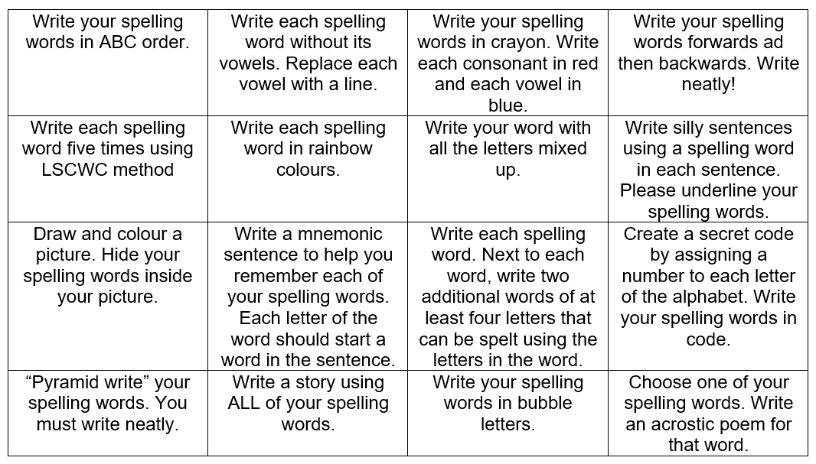
Spelling Practice Ideas

Slide 15
Homework - Maths
Your child has a maths homework book which they work in both at school and at home.
They need it in school on a Tuesday and Thursday.
They are currently working their way through the 99 Club: 11 club, 22 club, 33 club…….99 club, bronze, silver, gold.
They are tested on times tables.
If they complete a grid within 5 minutes, it is marked. If they don’t, it is not.
100% means the child moves to the next level.
Please practise at least three times a week.
All club sheets are available on the school website.
Maths homework sheet will be given out in yellow book Friday to be completed by Thursday the following week

Slide 16
Trips and events
Please check the calendar on class dojo regularly.
14-16 September PGL Residential- an information meeting has taken place and presentation posted on class dojo. PLEASE FILL IN A PERMISSION FORM Please email/speak to Mrs Roberts/Miss Kershaw if you have any further questions.
Monday 12th October – Autumn walk 1.30-3.30 pm Wincle area
Trips and events in the planning stages:
Macclesfield Academy Science afternoon
Bikeability – level 1 on the school playground
Bikeability - level 2 Macclesfield Leisure Centre

Slide 17
When and how we assess
Continually assessing across the curriculum using mini tests
Maths, English and some afternoon subjects will be marked by staff.
Live marking where possible with verbal feedback from staff
Assessment week – mixture of shorter tests over several days and some longer tests for Y6 to learn test techniques
Half way through each term, there will be a teachers at Parents’ Evening for an update on your child’s progress and attainment gathered.
At the end of each term, a data letter will outline your child’s progress and attainment.
If there are any concerns you will be contacted and we also ask you to let us know if you have any concerns

Slide 18
School Websites
In daily teaching and learning, the children access a range of educational websites to research information, play games,complete activities and watch videos.
Key educational websites used include: Purple Mash, White Rose,NCETM mathsframe.co.uk, topmarks.com, timestables.co.uk, Master The Curriculum, BBC Bitesize, Dyslexia Gold, Kiddle,Nessy Spelling, STEM Science including Explorify, Questful RE Diocese of Blackburn resources, cavelanguages.com, greenmouse.com.
Teachers and support staff may also use other websites to support their teaching. These are all viewed prior to the lesson to ensure they are safe and appropriate.
These websites include: Youtube.
If the children choose to watch a film as their class treat, Disney Plus or Netflix may be used to stream the film. Films will be selected in line with the MPA movie rating system.

