Slide 1

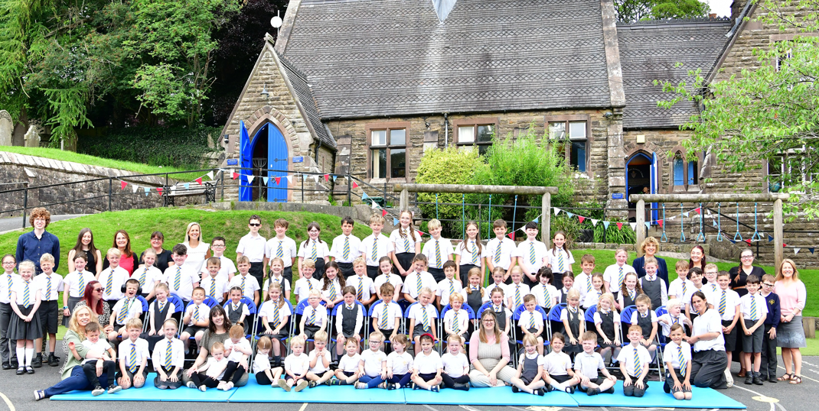
Wincle CE Primary School
www.wincleprimaryschool.org
https://www.facebook.com/Wincle-CE-Primary-School-
‘Shine Like Stars’
Philippians 2: 15

Slide 2
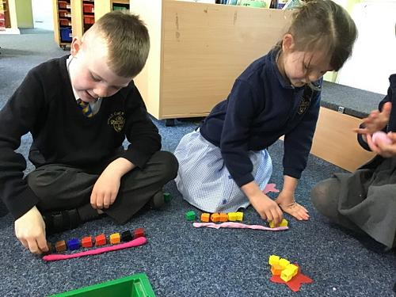
Welcome...
Introductions...
Aims...

Slide 3
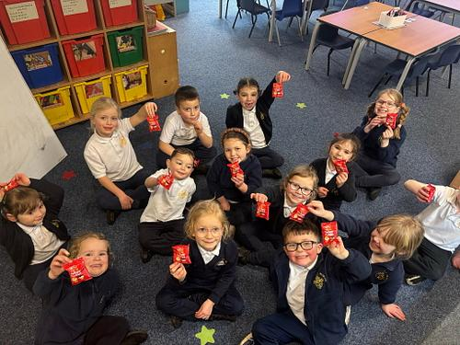
Our Christian vision:
Wincle School creates an enriching and outstanding rural education. We nurture the whole individual: body, mind and soul, inspiring rounded, happy, courageous children who shine in all that they say and do. Our children exhibit a passion for learning, a confident faith, a loving concern for community and an inclusive respect for all.

Slide 4

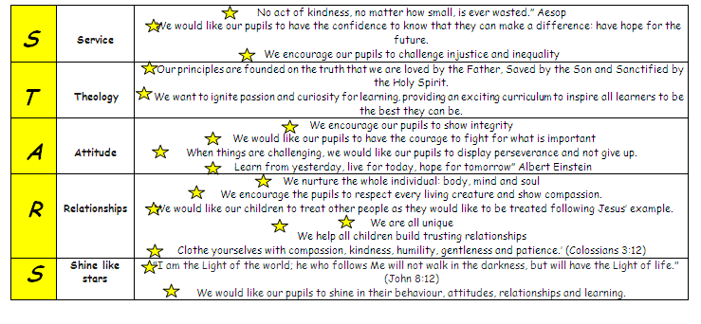
Shine like stars!

Slide 5
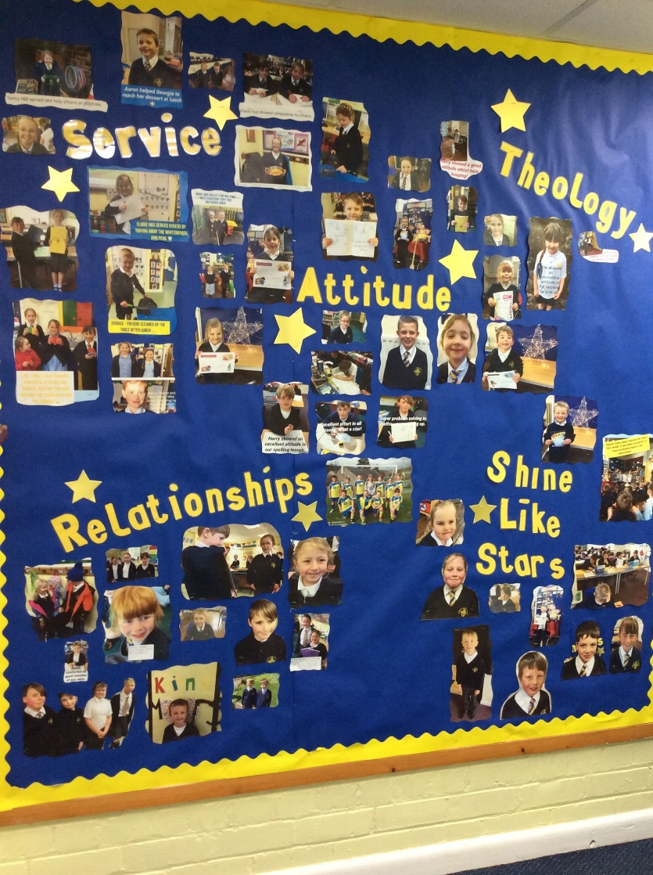
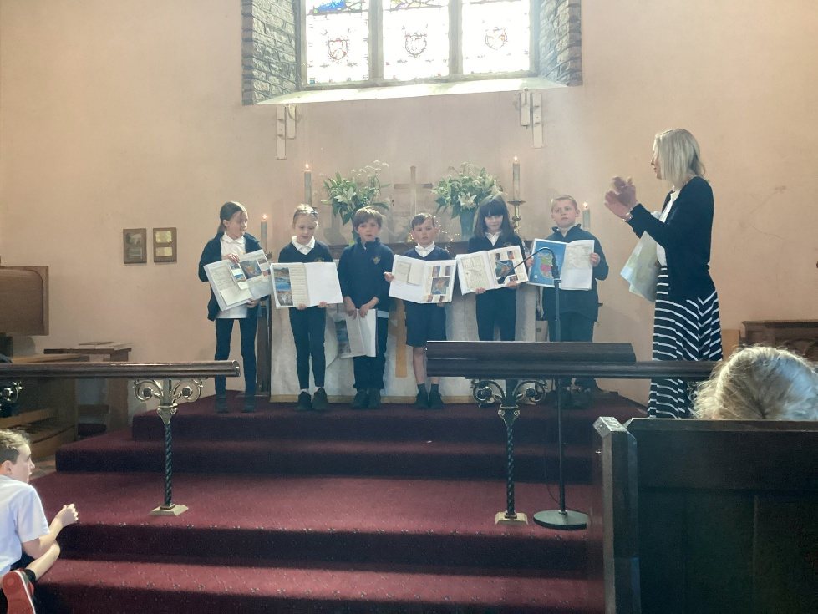
Celebrating….

Slide 6
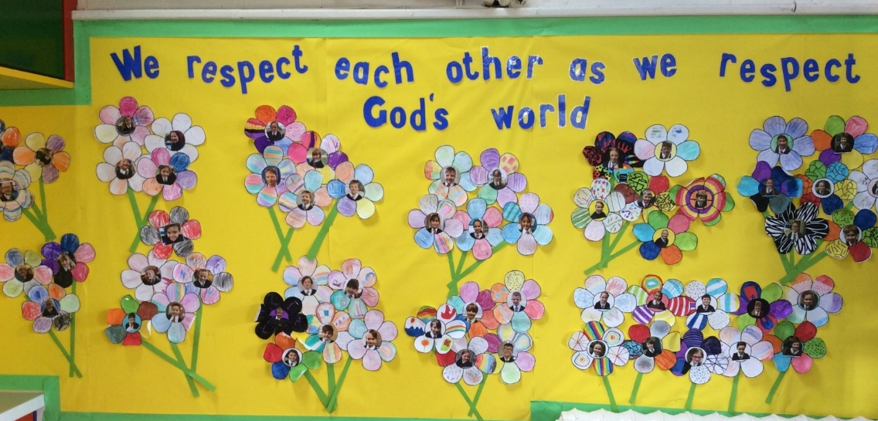
A church school
In everything that we do, we focus on our core Christian values of hope, respect, compassion, integrity and perseverance. Our curriculum runs with these values at the heart of all learning, regardless of subject.
Daily worship
Regular worship in church

Slide 7
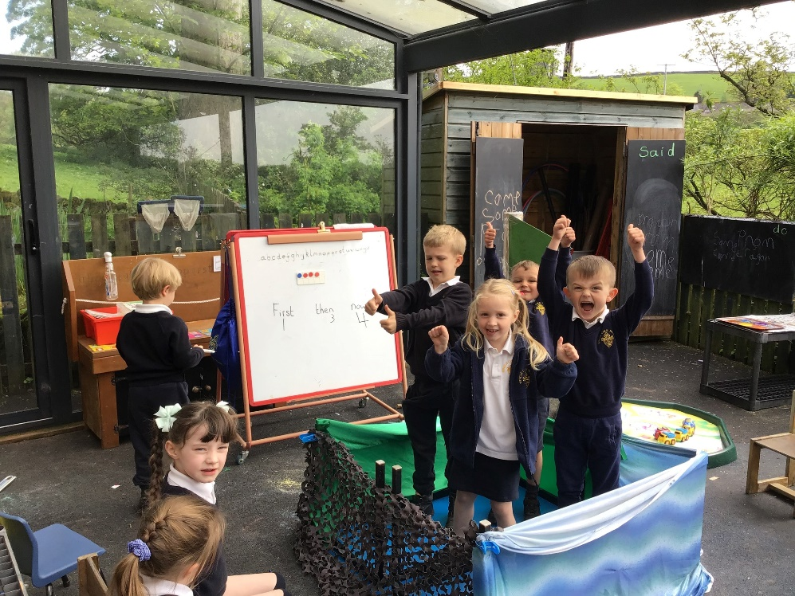
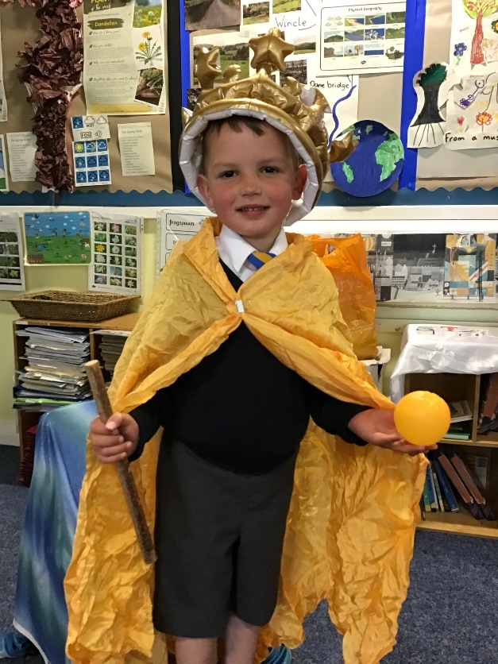
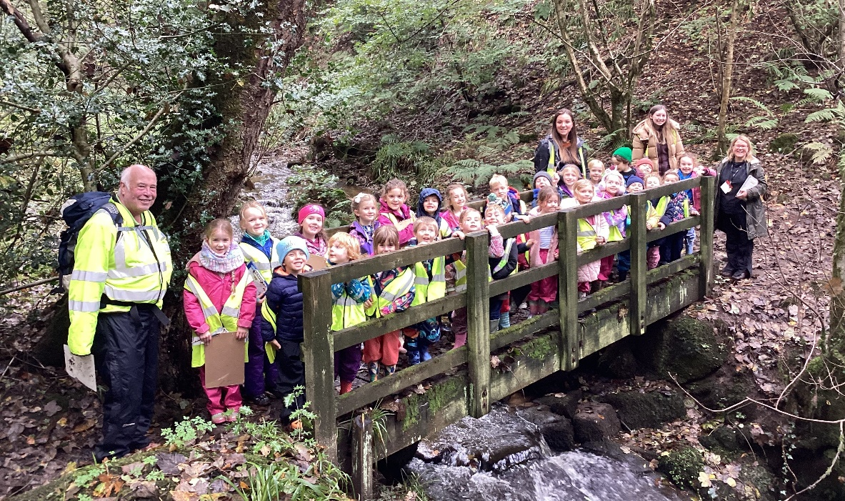
Our unique curriculum...

Slide 8

Our curriculum drivers
Our curriculum is based around a series of themes called drivers, which maximise cross-curricular links whilst ensuring rigour where there is a clear development in the learning of key skills. As a school we have identified the ‘curriculum drivers’ that personalise our curriculum. These have been chosen through consultation with staff – identifying the needs and interests of the pupils at Wincle CE Primary School.
Physical, Mental and Spiritual Wellbeing
The environment
Initiative
Communication

Slide 9

Emotional Wellbeing
As stated in our vision,
we nurture the whole
Individual.

Slide 10
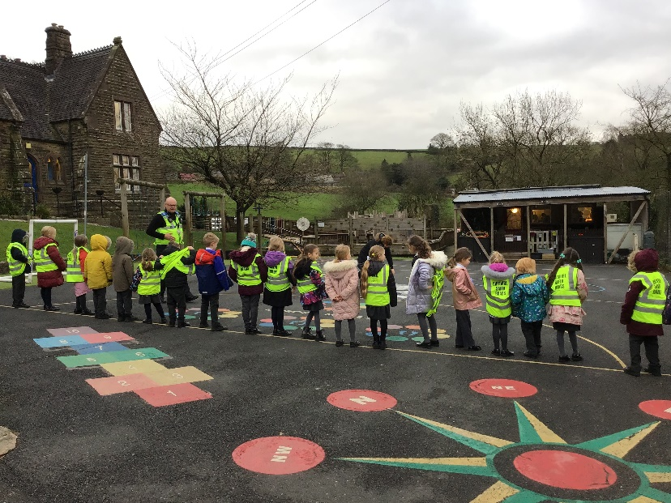
We help our pupils:
Stay safe and healthy
Look after God’s World
Live out our Christian ethos
Let their voice be heard
School committees

Slide 11


Slide 12
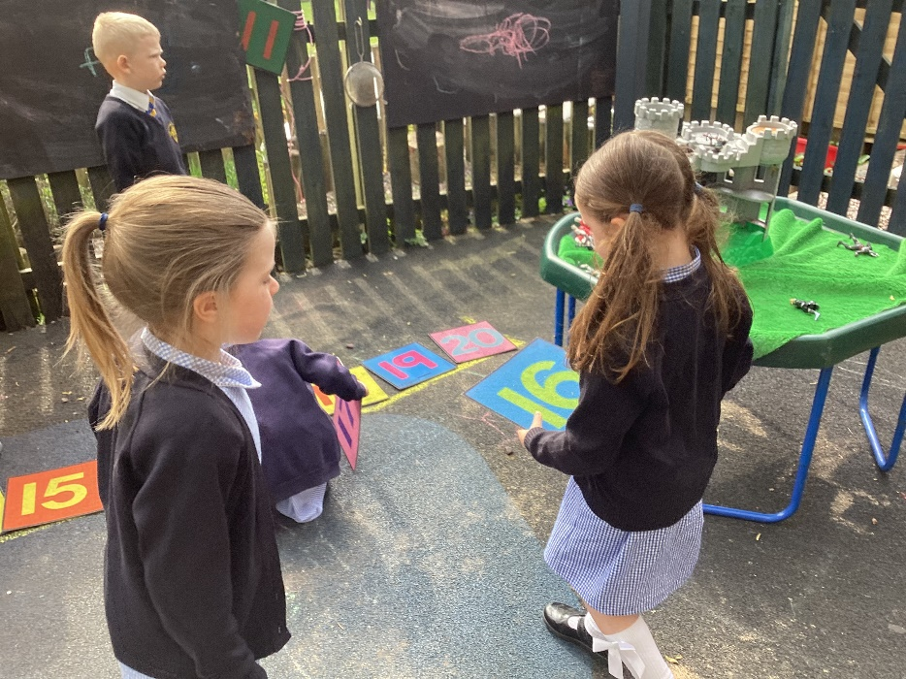
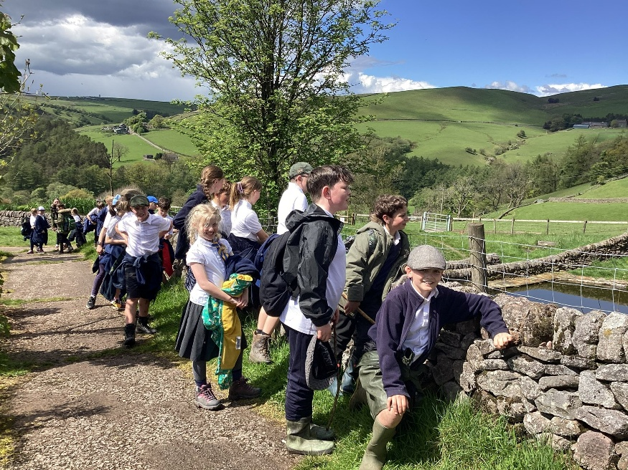
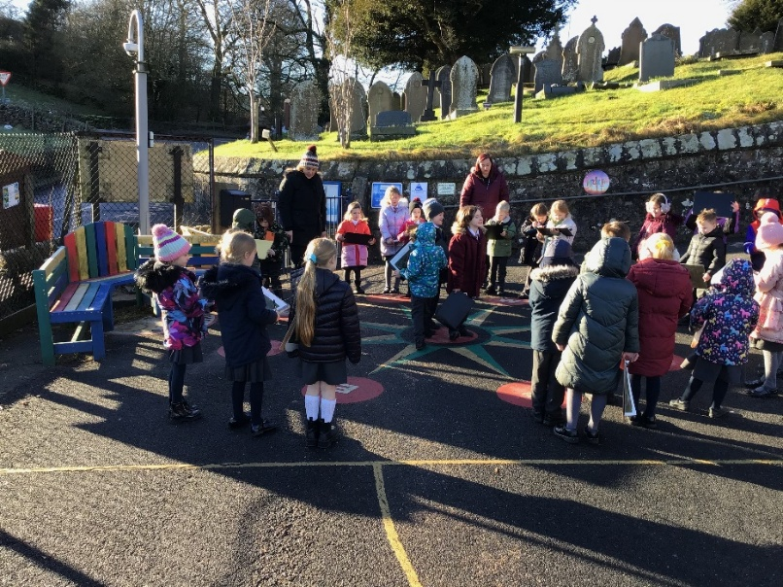
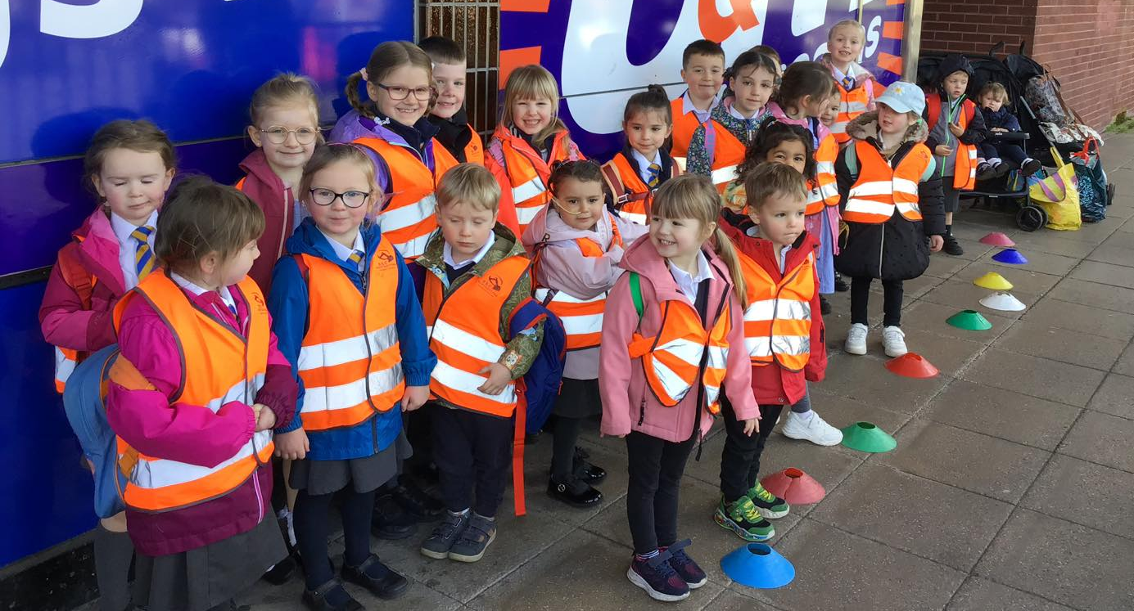
Outdoor learning:

Slide 13
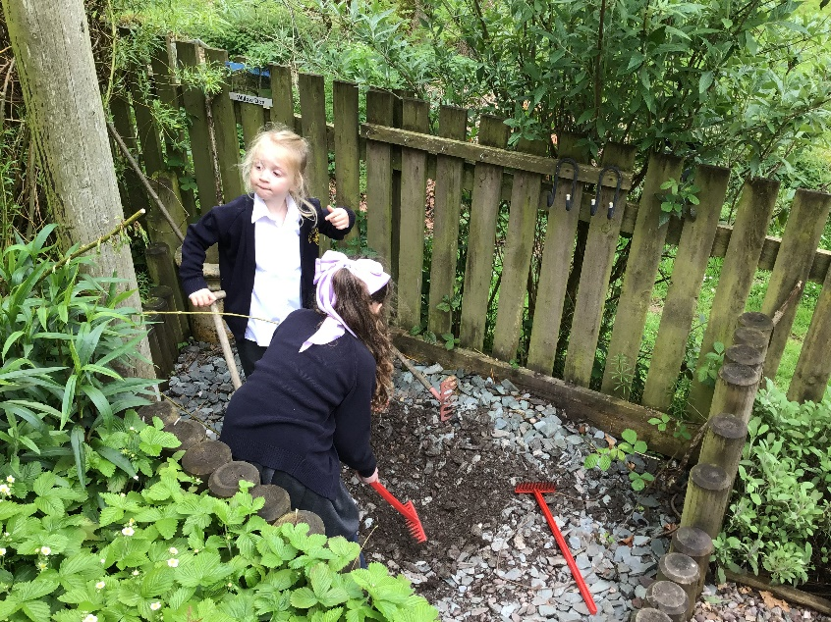
The school timetable:
8.45am: come and play on the playground
8.52am: the pupils will line up and start their school day
10.30am: playtime for all
12.15pm: lunch for Mars Class
12.45pm: outdoor play
3.30pm: end of school day

Slide 14
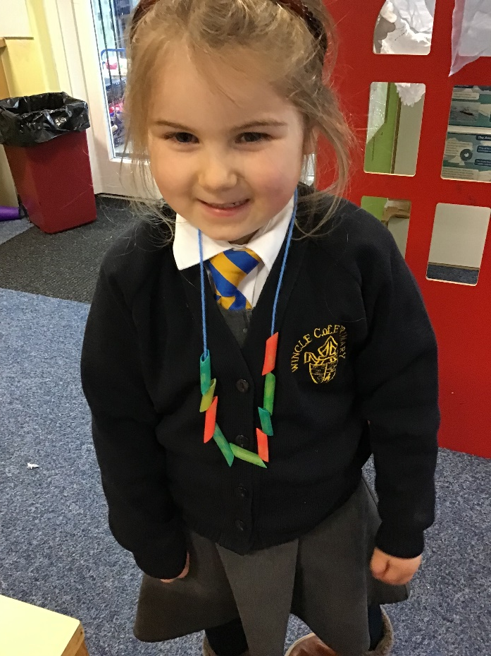
Primary school in September:
Preschool
Rec/Year 1/Year 2 (Mars)
Years 3/4 (Saturn)
Years 5/6 (Jupiter)

Slide 15
Meet the staff of Mars Class:
Teacher: Miss Braddock
Teaching Assistants: Mrs Mollart
Mrs Goodwin
Mrs French
Mrs Cookson

Slide 16
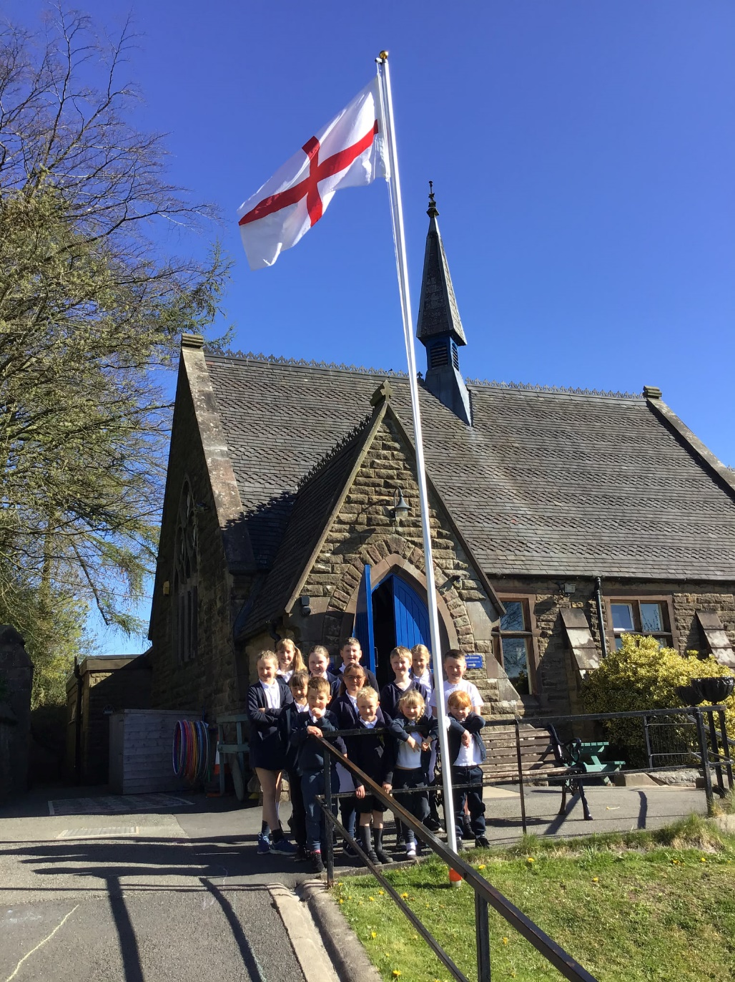
Saints Groups
St. George
St. Andrews
St. David
St. Patricks

Slide 17
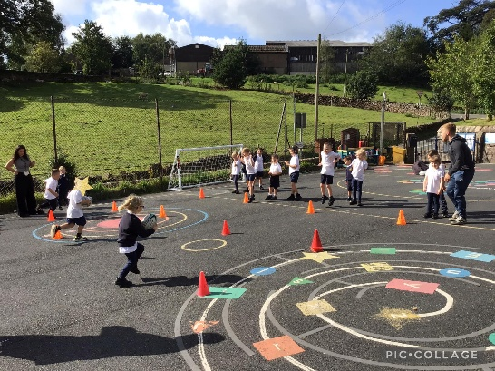
Transition
To help prepare your child for their start at Wincle, we
have many transition events in school planned on:
Wednesday 1st July at 1.10pm-3.30pm: move up afternoon
Friday 3rd July at 2.30pm: pupils invited to join Mars’ story time 2.30-3.30pm
Tuesday 7th July at 12.15pm: pupils invited for lunch
with the current reception 12.15-1.00pm
Monday 13th July at 9am: second move up morning till 12.15pm
The teacher, Miss Braddock, will be visiting your child in their pre-school setting to observe, interact and find out as much as possible prior to them starting in September. We are also wanting to visit your child in their family home to begin to build our relationship and see what is important to them in their lives.
This evening is the perfect opportunity to find out as much as possible about the school but also for you to give us valuable information about your child.

Slide 18
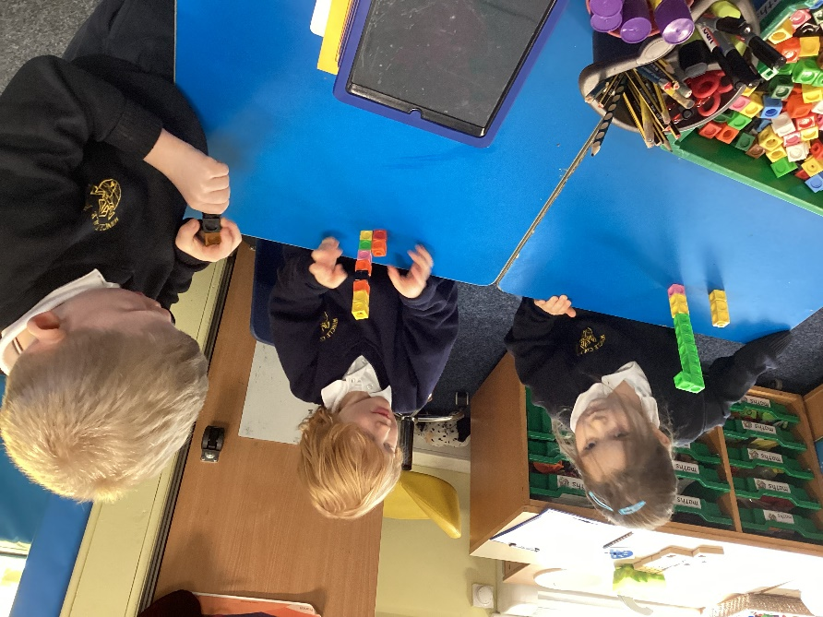
This September...
School begins on Wednesday 2nd September and pupils attend full time from the very first day.

Slide 19
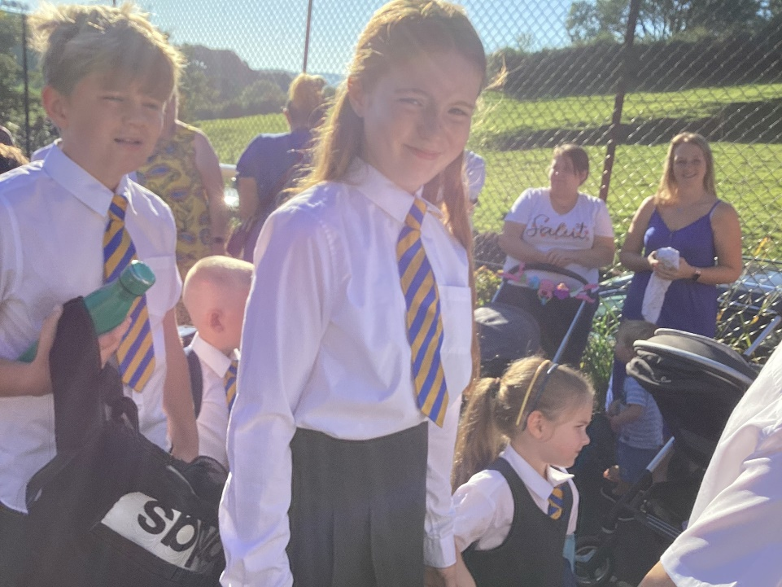
Key information about starting
Buddies: you will be notified of your child’s buddy in the holidays.
New Starters’ Service: this will take place on Wednesday 2nd September at 3pm. Please join us if you can.

Slide 20
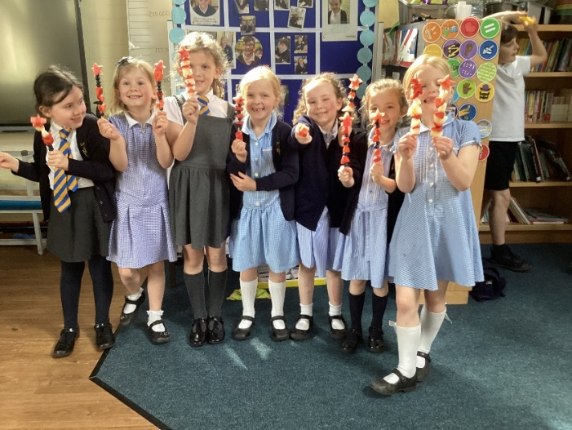
Before and after school care..
Breakfast club: £4 from 7.45am.
Wraparound provision is called All Stars.
Price is £9.50 from 3.30-6.00pm.
First Hour - £4

Slide 21
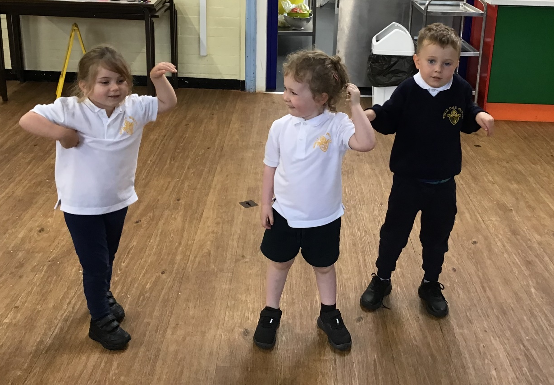
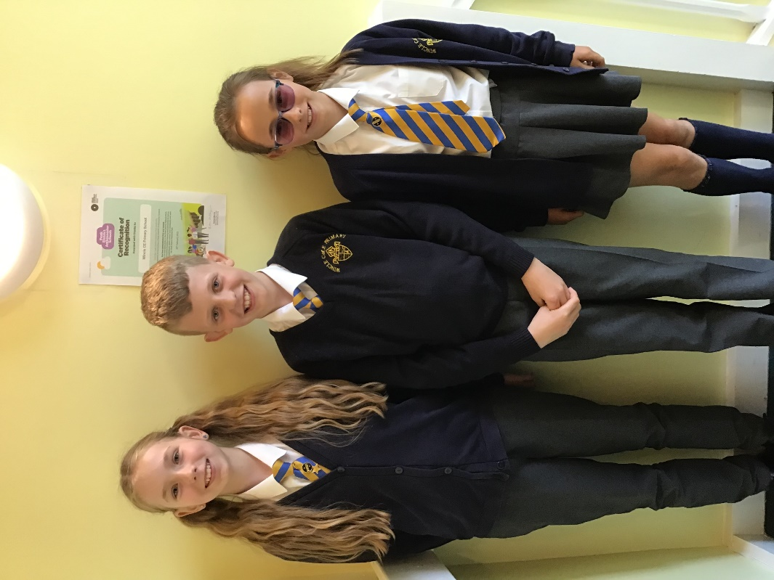
School uniform

Slide 22
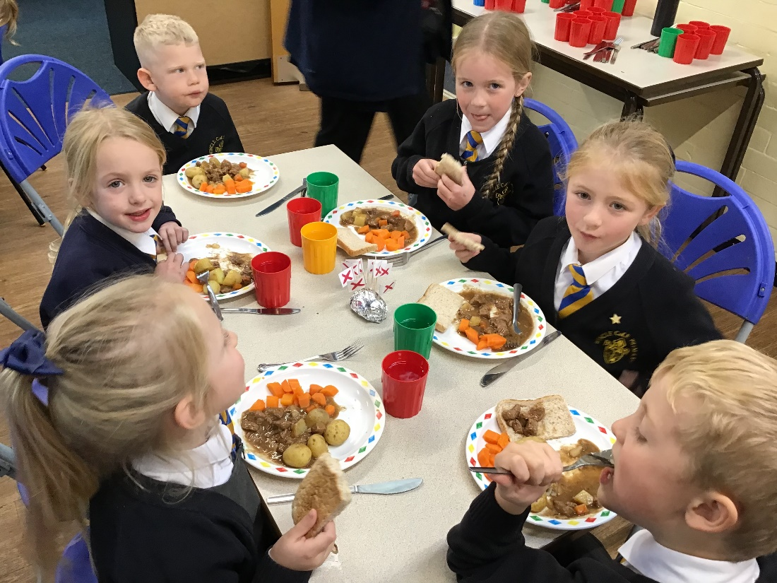
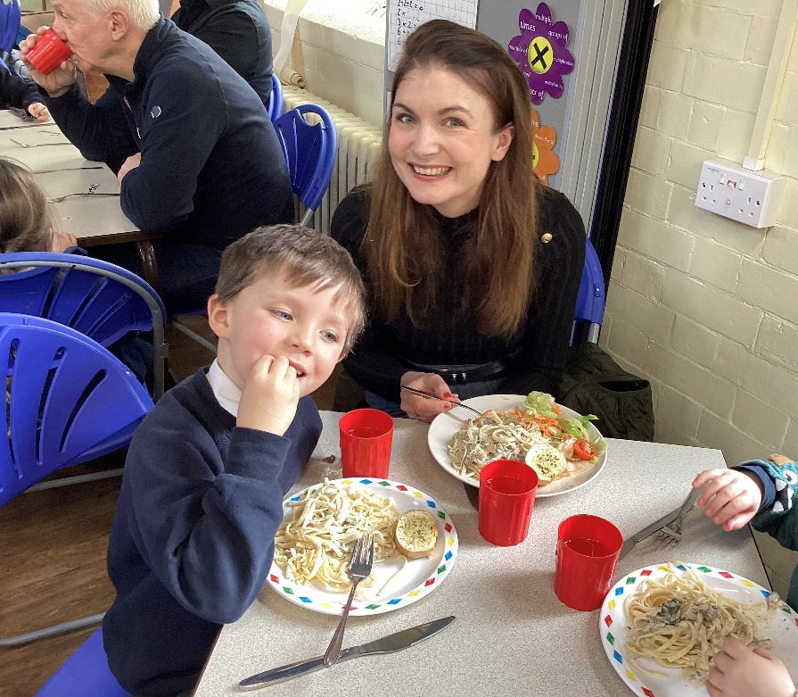
School lunches

Slide 23
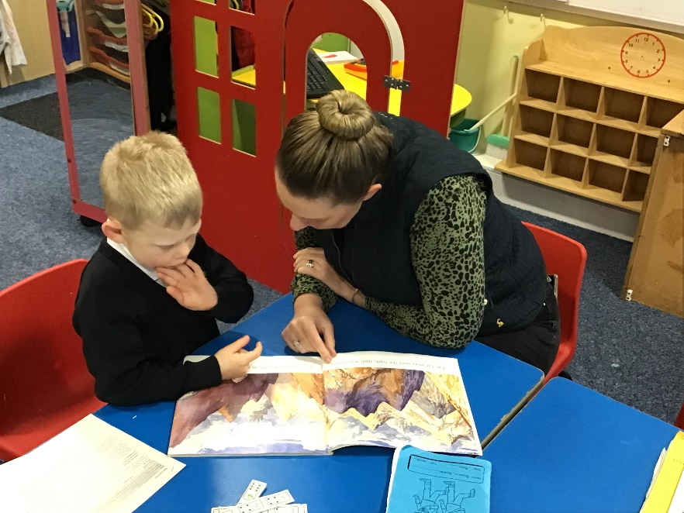
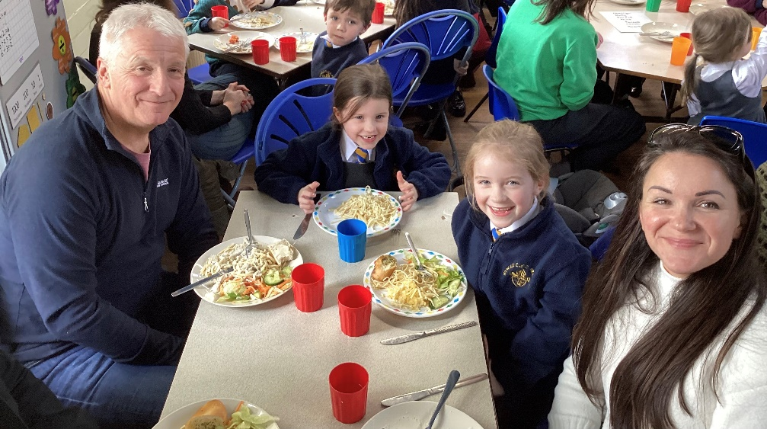
Parental Involvement:

Slide 24
The door is always open…..

