Slide 1
Welcome!
Meet the teacher.

Slide 2
How to get in touch
Speak to at the door at the beginning/end of the day
Email - sbraddock@wincle.cheshire.sch.uk
Dojo message
Note in the homework diary.

Slide 3

Dojo
Updates on what we are doing as a class.
Reminders about homework, trips or lessons we’re doing.
Celebrations of children’s work.

Slide 4

Attendance and punctuality
Read more on our school website
Regular school attendance is essential if children are to achieve their full potential.
Even if a child is feeling a little “off” please do try to bring them in.
If children have been ill in the morning and then perk up, please bring them in for the afternoon session.

Slide 5
Behaviour / Communication
We put relationships first and nurture positive relationships. This is modelled through how we communicate with each other.
‘behaviour is communication’ approach
We maintain clear boundaries and expectations around behaviour. Children need predictable routines, expectations and responses with sufficient flexibility to allow an empathetic and personalised approach.
Class Agreement created.

Slide 6
Behaviour / Communication
Verbal praise (a kind word or just encouragement).
Praise from teachers, support staff and the Headteacher.
Positive feedback about work or behaviour (verbal or written).
Headteacher’s Award
Sharing examples of children’s work.
Encouraging the children to praise each other.
Special praise through other staff recognition in School Assembly.
Recognition board
Dojo points (coming soon)

Slide 7
Behaviour / Communication
Tactical positioning of teacher to eliminate problem.
Praise of other children behaving well.
Whole class reminder of Class Agreement and Class Rules.
Yellow – Reminder of expectation
Amber – Warning of behaviour
Red – Sent to Headteacher, parents informed.
Time out from the classroom, working through tasks in isolation where appropriate with support/supervision.
Loss of privileges, (free choice of activity, playtime or lunchtime).
School Behaviour Report.

Slide 8
E-Safety
E-safety is taught to children as part of the computing and PSHCE curriculum and is regularly revisited.
Monitoring and open communication with your child is key.
Government recommendations – maximum 1 hour of screens a day
Additional advice/ support is always available

Slide 9
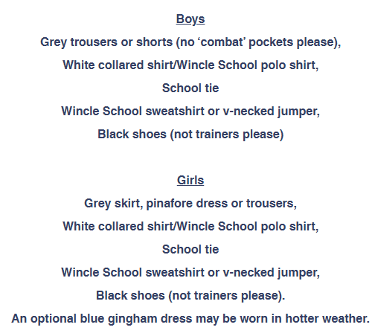
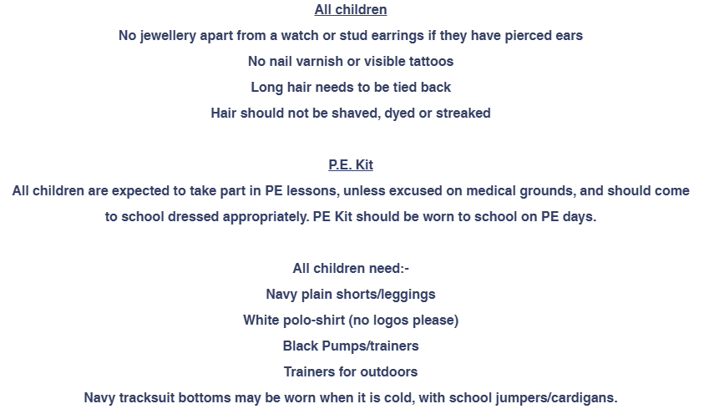

Slide 10
What to bring to school daily:
A water bottle (with water only).
Blue reading record.
Current reading book.
Maths homework book.
Phonics homework book.
Coat – always, not matter the weather
Please do not bring any toys, fidgets or other home items unless spoken with the Teacher.
Please put names on everything.

Slide 11
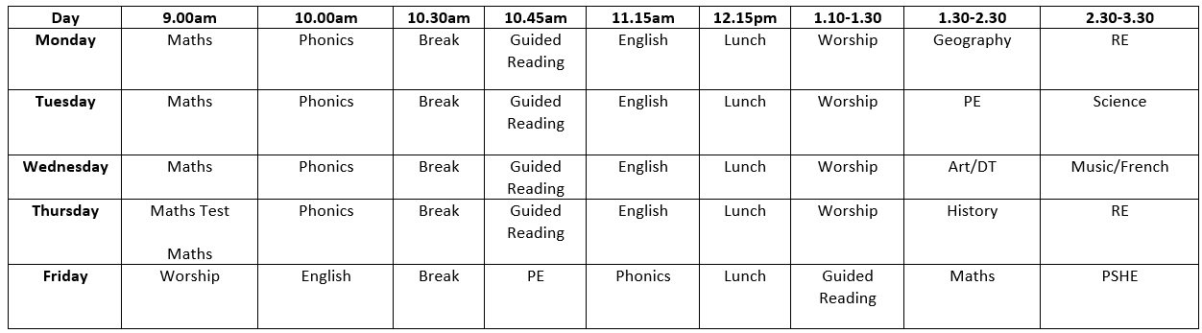
P.E. Routine
Tuesday – come to school in P.E. kit
Friday – come to school in P.E. kit

Slide 12
Homework Expectations
Reading: To read with an adult daily or as often as possible throughout the week. Bring reading records in every day. Minimum reading 3 times school-book.
Phonics: Sheet stuck in practises phonics taught in the week.
Maths: Sheet stuck in practises phonics taught in the week.
Homework given out on Friday, due in on Thursday.
Homework won’t be marked but will be tracked.
1 Dojo for Reading, 1 Dojo for Maths, 1 Dojo for Phonics - Over the half term, if they get 18+ homework dojos, each child will win a treat
Homework club run by Mrs Smith on Tuesday lunchtimes.

Slide 13
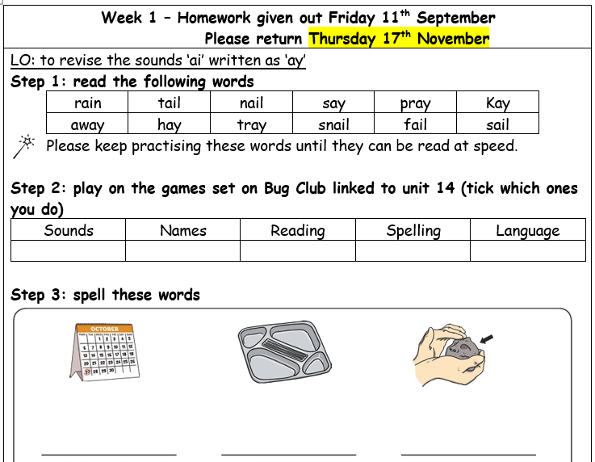
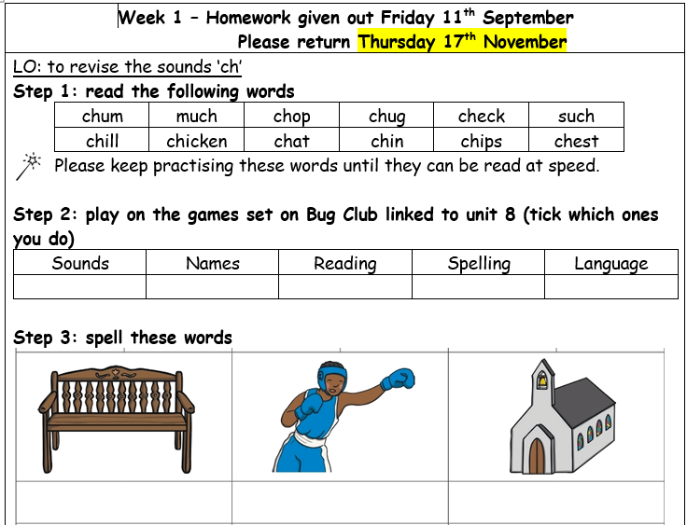
Homework
Some activities might need a die. If you need to borrow one, please let us know.

Slide 14
Bookmark to help with comprehension
BugClub

Slide 15
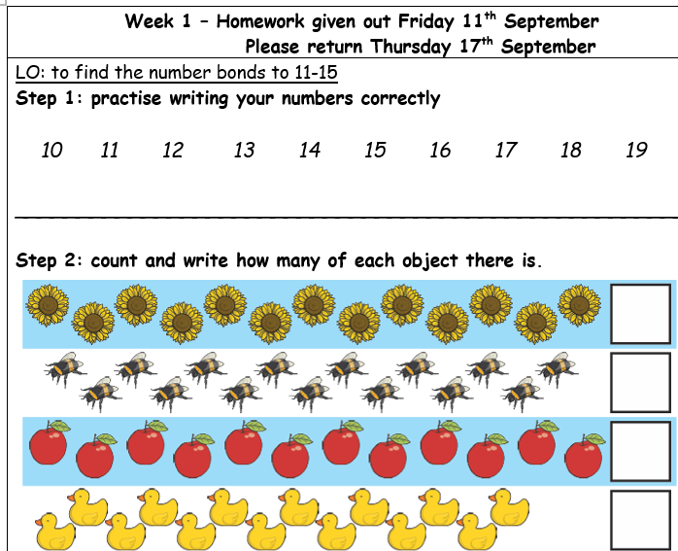
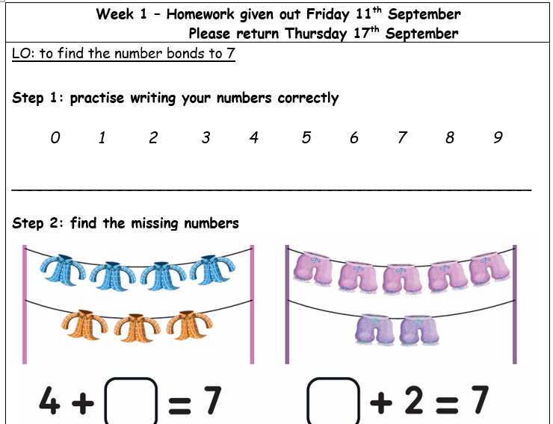
Homework

Slide 16
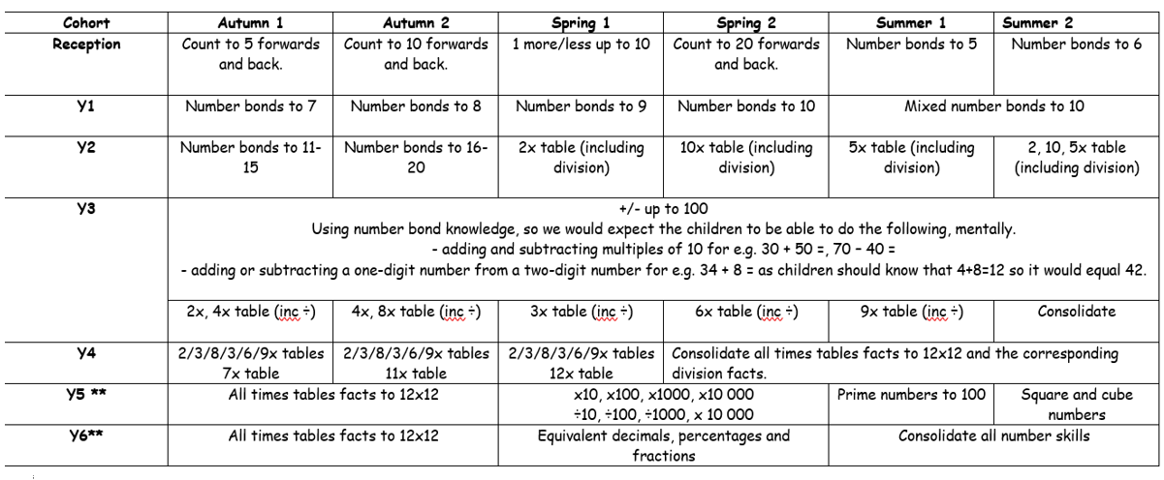
Mental Maths Focuses

Slide 17
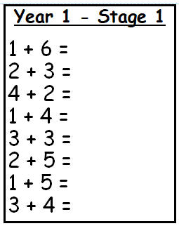
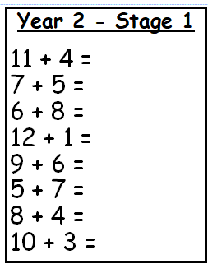
Weekly Maths Test
Thursday morning – stuck in the back of Maths Homework books

Slide 18
Spencer Bear
Spencer Bear will be given out on Wednesdays and be brought back on Tuesdays.
We ask that you fill the scrapbook with photos and memories that you make with Spencer.
Please don’t feel pressure to do any extravagant for this. It could be visiting Grandparents, going the park, doing the weekly shop or practising homework together.
Examples seen in the old books.

Slide 19
Family Maths and Family Reads
Dates (from Newsletter):
24th September at 3.10pm - Family Reads
20th October at 3.10pm – Family Maths
18th November at 3.10pm – Family Reads
11th December at 9.00am – Family Maths

Slide 20
Parents Readers
Parent Readers- if you are able to spare a short amount of time each week (if even just for a few weeks) to listen to children read, we would be extremely grateful. Please contact me if you are able to volunteer.

Slide 21
Thank you
Any questions?

