Slide 1
Meet The Teacher - Saturn
September 2026

Slide 2
Staff In Class
Miss Williams will be teaching full-time, with Miss Kershaw covering PPA and ECT time on Monday and Tuesday afternoons.
Mr England will be supporting every morning in Saturn classroom.
Mrs Cookson will also be supporting on Tuesday, Wednesday and Thursday mornings.
If you would like to speak to a member of staff and you feel it is urgent, please do get in touch with the admin team who can pass on a message. If not, please speak to us at the end of the school day or via Class Dojo. We aim to reply within three working days between the hours of 7:45am and 5:30pm.

Slide 3
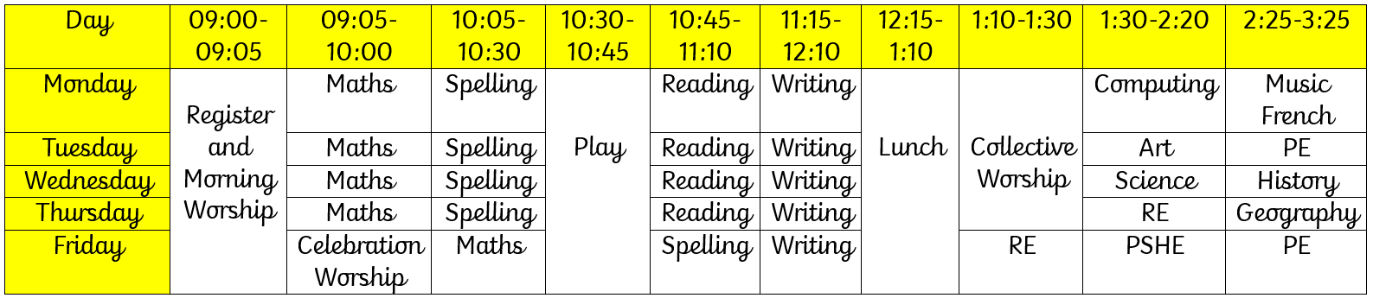
Weekly Timetable

Slide 4
Daily Routine
To begin the day, the pupils identify which ‘zone’ they are in on our emotions check in.
It would be really helpful if parents could use this language at home too: please ask your child to explain the four zones and help them identify what helps them move from one to another.
On Tuesdays and Fridays, Miss Williams will stamp the children's diaries. Please encourage your child to write in their diaries - we love to see what they have been doing! (Homework, clubs, learning new skills etc.)
Regular whole-class movement breaks are scheduled so that pupils do not have to sit for long periods of time, so they can focus during learning.
Please see Saturn’s long-term plan on the school website for topics covered across the curriculum.

Slide 5
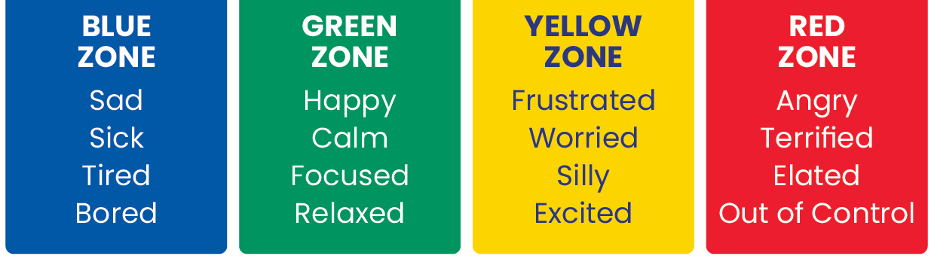
Zones of Regulation

Slide 6
Rewards and Sanctions
Each day, we have a ‘Star of the Day’ - a pupil who has displayed one of our school values. This provides us with ample opportunities to discuss our values and ensure the pupils understand them.
Individual dojos are recorded digitally each day, and the children will be able to spend these at the Dojo Shop at the end of each term. Whole class dojos are counted towards a class treat.
Stickers and stamps are given to reward for effort and hard work.
For children showing exemplary effort, they will be able to choose a reward from Miss Williams’ treat box.
Certificates are awarded in Celebration Worship on a Friday. These are earnt, and we do not work our way down a class list.

Slide 7
The Card System
What is the point of the system?
To give a clear, consistent approach so children know exactly what
is expected and what is going to happen.
What does each card mean?
Yellow – to explain what we would like to see.
Orange – to give a warning.
Red- a consequence for continued poor behaviour.
Why do we not just say, “no”?
This is meaningless to most children.
Notes:
DLD is very common but very few people know what it is. Compared to other developmental difficulties it is much less well known. DLD is a broad term and children can have a range of difficulties.
The term DLD replaces the terms Specific Language Impairment (SLI) and language delay, which you may have heard before. As a department we follow the generally accepted guidance that DLD is not diagnosed before age 5, however we may indicate that we suspect a child has DLD prior to this if we have sufficient grounds.
It covers a wide range of difficulties and the children who have a DLD diagnosis are a very diverse group. Some may have other difficulties (such as LD, ASC), some may not. Some may have normal cognitive levels, some may not. Some may have difficulties that are very obvious, for some the difficulties may be quite well hidden or may present as something else (e.g. behaviour, reluctance, low confidence).
The profile of children with DLD is also unique – some children have no difficulties understanding but they cannot express their thoughts and ideas through language. For others both understanding and expressive language are affected. This will be outlines in the child’s report and/or communication profile.

Slide 8
The Card System
I am showing you a yellow card because you are…
Please do …. Instead.
You are still…
This is your warning.
Please…
I am showing you a red card because…
We will now…
We will write in a child’s diary or send a message via Class Dojo if they receive a red card.

Slide 9
The Card System
I am showing you a yellow card because you are…
Please do …. Instead.
Yellow shouldn’t be a serious situation.
Yellow is any situation where a child needs to be reminded of the expectation.
Using yellow at the right time prevents the behaviour progressing and prevents red from being a sudden shock.

Slide 10
Homework – New This Year
Our approach to homework has been adapted this year to incorporate more of the successful strategies from across the classes.
Your child will be given 3 pieces of homework each week: reading, spelling and maths.
Reading – reading a school reading book 3 times weekly.
Spelling – a worksheet and independent practise.
Maths – an arithmetic sheet.
When diaries are checked on Tuesdays, children will be awarded 1 ‘Homework Dojo’ for each of the three pieces of homework completed in the previous week.
If they receive 18 Homework Dojos in the half-term, they will be given a reward.
Homework books will be stamped by teachers, but we kindly ask that you mark the homework with your child. It is important to identify misconceptions in the moment.

Slide 11
Homework – Diaries and Reading Books
Children’s diaries are checked for messages two times a week – Tuesday and Friday.
Please also use Class Dojo to communicate with the class teacher should you have any queries.
Please support your child to write each time they have completed homework so they can earn homework Dojo points.
*I have created a bookshelf full of my own books which the children can borrow to read at home. I have introduced them to the system for this, but please look after and return these books when you have finished reading them.

Slide 12
Homework - Reading
Pupils have been allocated a book band based on their reading ability.
Please read this book three times across the week and record the title and page numbers in diaries.
KS2 pupils should be reading for at least 20 minutes each session.
Reading out loud is vitally important and helps adults check the reading ability for the child. Please listen to your child read where possible.
Reading fluently, using the punctuation correctly, ensures a child has a chance of understanding what they are reading.
It also allows for new vocabulary to be shared.
It is also important that pupils read books of their choice for pleasure, and that they hear adults reading and modelling fluency.

Slide 13
Homework - Spelling
This year, the pupils will have a school spelling book and a spelling homework book.
At home, complete the spelling worksheet/activity set for the week. This will contain words that follow the rule being taught each week.
Please also practise the words from the weekly overview, including common exception words, using a method of your choice.
Group 1: highlighted words only. Group 2: all words on the overview.
The weekly spelling overview is available on Saturn’s Class Dojo Story.
A grid of spelling practice ideas is attached on the next slide.
Every Monday, the children will complete a spelling test and scores will be recorded.
All children will be tested on 10 of the spellings: they will be tested on the 4 common exception words and 6 of the spelling rule words. Individuals will be made aware of any adaptions.
I encourage you to practise writing each spelling as a whole, several times, to embed spellings. There is a strong correlation between handwriting and spelling.

Slide 14
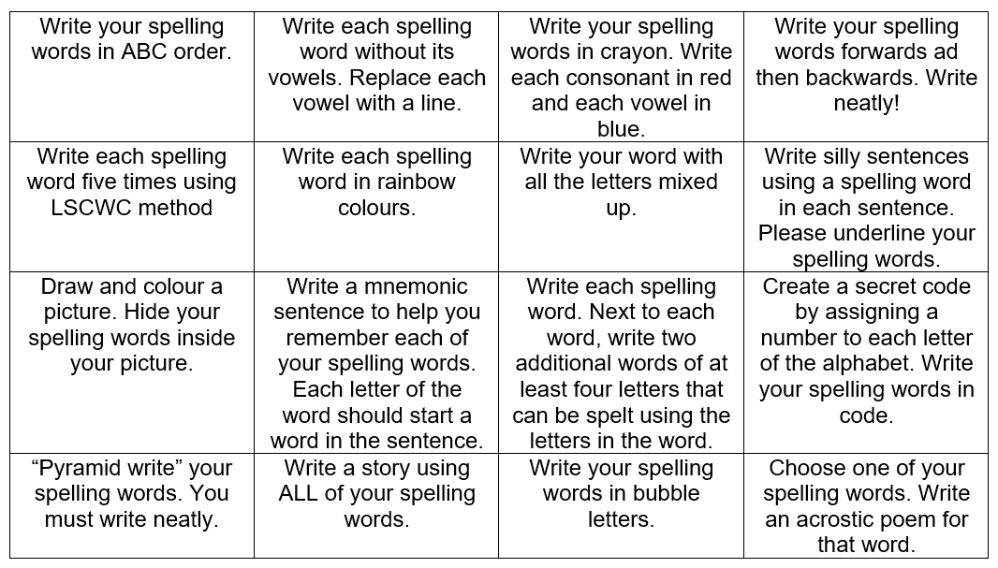
Spelling Practice Ideas

Slide 15
Homework - Maths
This year, the children will have a maths homework book which they work in both at school and at home.
At home, the children should complete the arithmetic sheets, aiming to score full marks.
Once you have achieved full marks, move onto the next sheet.
All children will complete a times table test every Tuesday.
Your child will be tested on the most recent sheet they have been practising.
These arithmetic sheets are progressive and once your child is secure on their current sheet, they will move onto the next one.
In the summer term of year 4, the children will complete the MTC, where they will be tested on 25 random times tables up to 12x12.

Slide 16
Trips and events
Please check the Saturn Class Story and Calendar regularly for updates and information.
Burdwardsley Residential – Wednesday 14th- Thursday 15th October.
Miss Williams and Mrs Smith will be taking the children on an Iron Age adventure! More information will be shared very soon.
Geography Field Trip – Thursday 5th November (afternoon). TBC
Any information regarding future trips will be given in due course.

Slide 17
When and how we assess
Continually assessing across the curriculum.
Maths and English, as well as Science and RE will be marked by staff.
Other afternoon subjects will be live marked by the children, with staff support.
Formal assessments will take place across the year. These will be spread across several weeks and involve a mixture of short quizzes and more formal papers. Formal papers will be chunked to support the pupils whilst also preparing them for the reality of ‘tests’.
Halfway through each term, you will meet with the teachers at Parents’ Evening for an update on your child’s progress and attainment.
At the end of each term, you will receive a data letter outlining their progress and attainment.
If we have any concerns, we will contact you via Class Dojo.
If you have any worries or queries, please contact us via Class Dojo at any time to see how your child is getting on.

Slide 18
School Websites
In daily teaching and learning, the children access a range of educational websites to research information, play games, complete activities and watch videos.
Key educational websites used include: Purple Mash, White Rose, Timestable Check, Master The Curriculum, BBC Bitesize, Dyslexia Gold, Kiddle and Nessy Spelling.
Teachers and support staff may also use other websites to support their teaching. These are all viewed prior to the lesson to ensure they are safe and appropriate.
These websites include: Youtube.
If the children choose to watch a film as their class treat, Disney Plus or Netflix may be used to stream the film. Films will be selected in line with the MPA movie rating system.

Slide 19
Final Reminders
Class Dojo is your base for viewing what the class are up to across the week, as well as contacting Miss Williams. You can also email and we aim to respond within 3 working days, between 7:45am and 5:30pm.
If you have any questions at all, no matter how small, please send a message on Class Dojo. I am more than happy to help and support you and your child.
I am also happy to share short videos modelling maths concepts, but please let me know if you would like any further support across the curriculum at home.

