Slide 1

Preschool
Parent information

Slide 2
Meet the preschool team
Mrs. Henshaw
Mrs. Tanswell
Mrs. Belfield
Mrs. Clack
Mrs French
PRESCHOOL STAFF
2

Slide 3
What to bring each day
01
Named water bottle
04
Reading book and diary
02
Coat
05
Hat and gloves
03
Bag
06
Sun cream and sun hat
PLEASE REMEMBER
Make sure all clothes are named and return spares promptly.
This helps us reunite belongings quickly and keep spare clothing available.
3

Slide 4
Preschool uniform
White polo
School jumper, cardigan or fleece
Comfortable bottoms
Shoes – shoes that the children can comfortably move around in, no crocs or sandals with open toes.
4

Slide 5

A typical week
6

Slide 6

The Early Years Foundation Stage
7

Slide 7

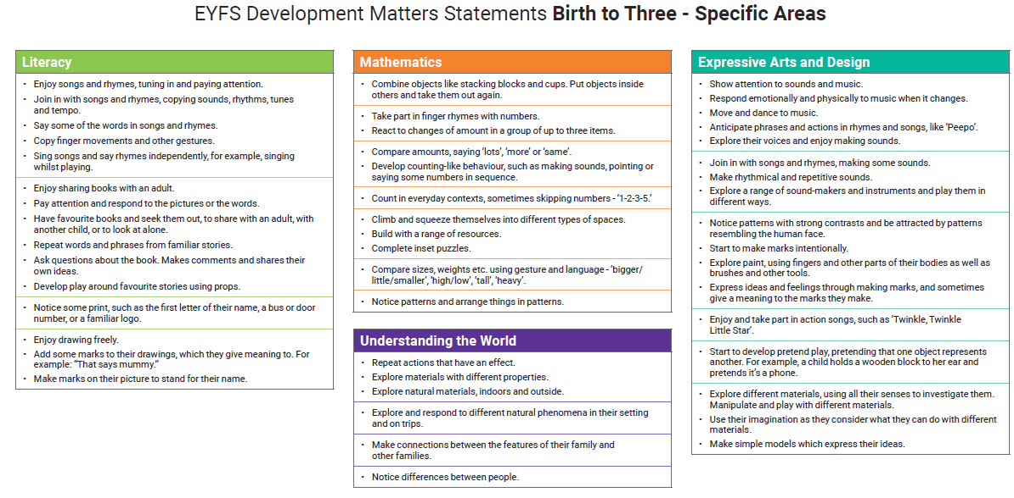
How we use the EYFS
Everyday using tapestry
Termly formal assessments based on the framework
Informs reports and data letters
8

Slide 8

Tapestry learning journal
One upload for each child per week as a minimum
Collects evidence for the EYFS Framework
Snap shots of the child's time in Preschool
Parents can also upload
9

Slide 9
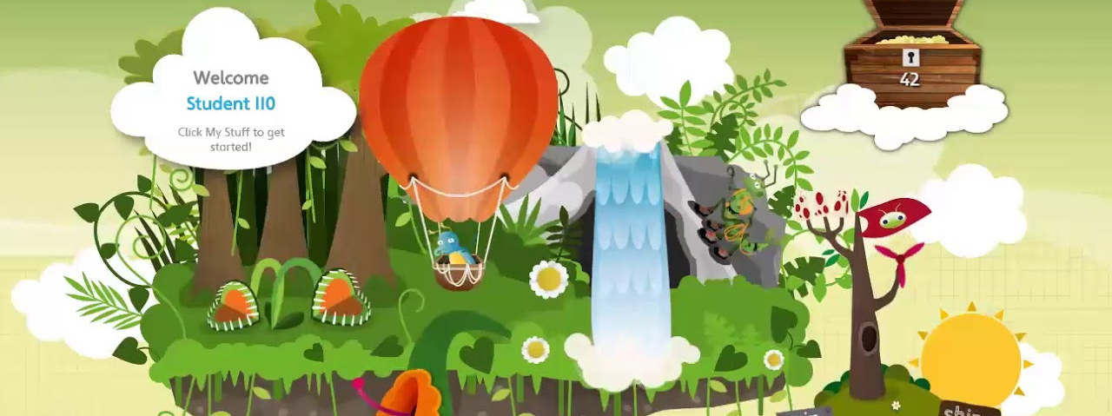
Bug Club
Login – AHenshaw
Pass word – cat123
School code – x7kk
10

Slide 10

Reading at home
Please send in the reading diary daily
Book changed twice a week
Please share a book 3x a week at home
11

Slide 11
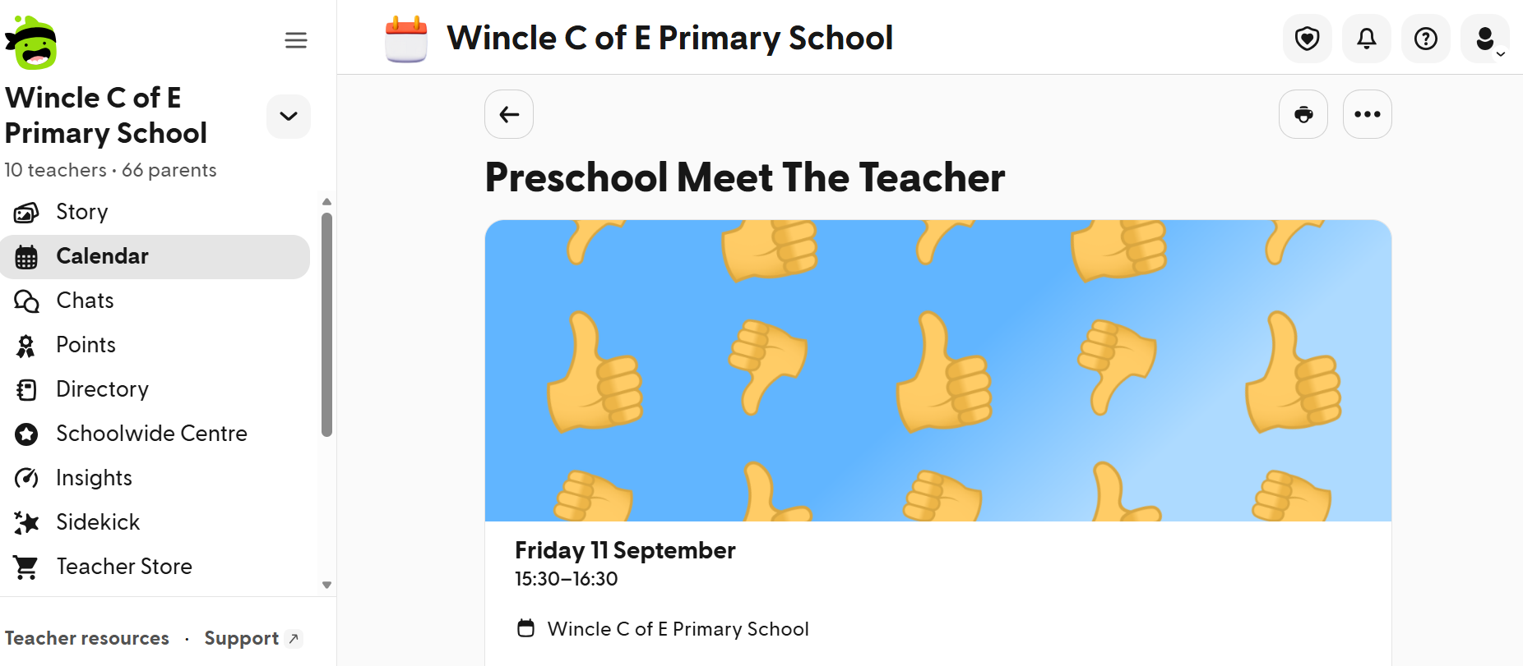
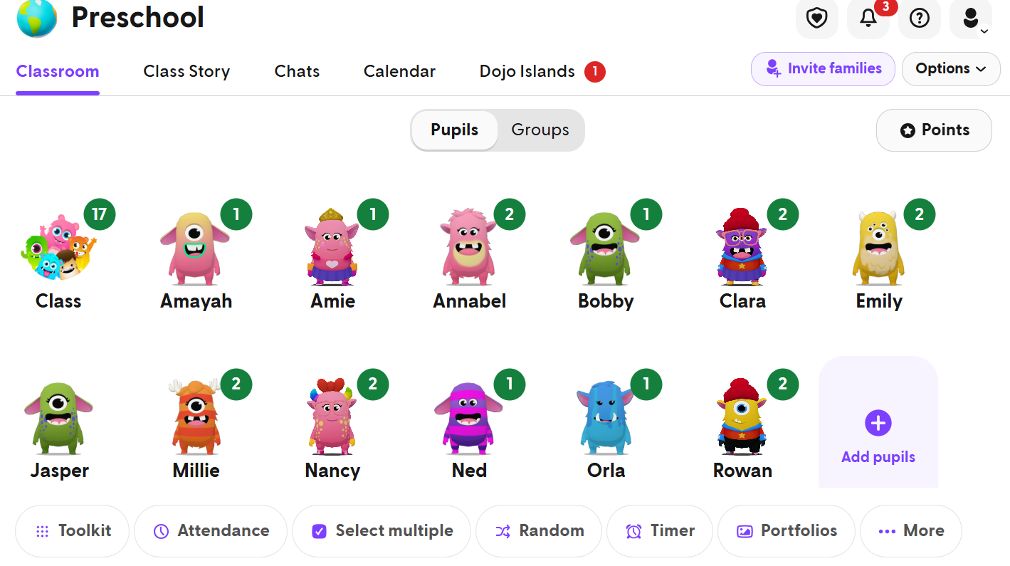
Class Dojo
16

Slide 12

Online safety at home
12

Slide 13


Healthy routines at home
13

Slide 14

All about me book
Information the children would like to share
Photos
Drawings
Will be sent home during the year
14

Slide 15


Things to remember
ATTENDANCE
THURSDAY
Please let us know whenever your child will not be in.
Forest School — bring wellies and waterproofs.
FRIDAY
CELEBRATION
PAS — children need trainers or shoes they can safely run in.
Friday worship includes Star of the Week and Secrets to Success. External awards are celebrated on the last Friday of the month.
FAMILY MATHS
FAMILY READ
Tuesday 20th October — 3:10pm
Thursday 24th September — 3:10pm
Wednesday 18th November — 3:10pm
15

Slide 16
Any questions?
ahenshaw@wincle.cheshire.sch.uk

