Slide 1
Welcome to Mars Meet the teacher!

Slide 2
Staff in class
Teachers
Miss Kershaw
Mrs Mollart: Tuesday and Wednesday afternoons
Support Staff
Mrs Cookson
Mrs Goodwin
Mrs Holmes

Slide 3
Communicating
If you have any concerns or worries, I am always available at the start or end of school for a quick chat. You can also email me; I will always aim to reply within three working days between the hours of 8 am and 5 pm.
We can always sort times for you to come into school for a chat if ever needed.
If there is ever an urgent message, please contact the admin team, who can also pass on a message to us throughout the school day.

Slide 4
What does our day look like?
8.45-9.00 | 9.00-10.00 | 10.00-10.30 | 10.30-10.45 | 10.45-11.15 | 11.15-12.15 | 12.15-1.10 | 1.10-1.30 | 1.30-2.30 | 2.30-3.30
Arrival | Maths | Phonics/ Spelling | Break for all | Guided Reading | English | Lunch (split) | Worship | Session | Session
Mars also have a playtime in between afternoon sessions.

Slide 5
Friday
8.45-9.00 | 9.00 – 9.30 | 10.00-10.30 | 10.30-10.45 | 10.45-11.15 | 11.15-12.15 | 12.15-1.10 | 1.10-1.30 | 1.30-2.30 | 2.30-3.30
Arrival | Worship | PE | Break for all | Phonics | English | Lunch (split) | Guided reading | Maths | Science
Mars also have a playtime in between afternoon sessions.

Slide 6
Afternoons
Day | 1.10-1.30 | 1.30-2.30 | 2.30-3.30
M | Worship | RE | RE (15 more mins) Music
T | Worship | Art or DT | PSHE
W | Worship | PE | Computing
TH | Worship | History | Geography
F | Reading | Maths | Science

Slide 7
Reading
Reception: On Mondays and Thursdays, in our guided reading sessions, children will choose a new reading book to take home.
Year 1: Once your child has read their book 3 times, it will be changed.
It is important that all children read their book at least three times through. This is to ensure that they have not just decoded words, but they have understood what they have read and worked on their fluency.
Feel free to record any other learning in your child’s diary for me to see or any other books they have read or enjoyed at home.

Slide 8
Daily routine
To begin the day, the pupils come into the classroom, put their water bottles down, and put their reading books in the wooden blocks. They are then asked to think about how they are feeling and place their peg on one of the zones here……
We are doing lots of work on the zones of regulation and linking it to all our learning!
Children then sit down on the carpet ready for the Hello song, our morning prayer, and we go through what the day will look like together.

Slide 9
Rewards
Each day, we have a ‘Star of the Day’: someone who has displayed one of our school values: Hope, Respect, Integrity, Compassion, Perseverance
The children put the corresponding colour feather in the jar depending on what value they have displayed. They also receive a value card. This is providing us with opportunities to discuss our values and ensure the pupils understand them.
Dojos are an individual reward. These are cashed in at the Dojo shop at the end of the term.
Stars in the jar. These are a class reward leading to a class treat of the children’s choice.

Slide 10
The Card System
What is the point of the system?
To give a clear, consistent approach so children know exactly what is expected and what is going to happen.
What should each card achieve?
Yellow – a reminder to explain what we would like to see. This is not serious and is just a reminder of the expectation
Orange – the behaviour is still being displayed after the yellow reminder
Red- a consequence
Notes:
DLD is very common but very few people know what it is. Compared to other developmental difficulties it is much less well known. DLD is a broad term and children can have a range of difficulties.
The term DLD replaces the terms Specific Language Impairment (SLI) and language delay, which you may have heard before. As a department we follow the generally accepted guidance that DLD is not diagnosed before age 5, however we may indicate that we suspect a child has DLD prior to this if we have sufficient grounds.
It covers a wide range of difficulties and the children who have a DLD diagnosis are a very diverse group. Some may have other difficulties (such as LD, ASC), some may not. Some may have normal cognitive levels, some may not. Some may have difficulties that are very obvious, for some the difficulties may be quite well hidden or may present as something else (e.g. behaviour, reluctance, low confidence).
The profile of children with DLD is also unique – some children have no difficulties understanding but they cannot express their thoughts and ideas through language. For others both understanding and expressive language are affected. This will be outlines in the child’s report and/or communication profile.

Slide 11
Online Resources
Tapestry online for reception parents to see their child’s learning. This acts like an online journal for your child and helps to gather evidence of all the key areas!
As the year progresses, their learning will be recorded in their books more often, so we may not need to evidence as frequently on Tapestry.

Slide 12
Online Resources
Bug club: This is the scheme we use to teach phonics in school but it is really great for home. It has online books for children to read as well as phonics games. I will continue to allocate books and games as your child move through units.
Each child has an individual login for this, which I will stick in your child’s diary for you to access at home.

Slide 13
Online Resources
Purple Mash – This is a great resource to use at home. It has so much for every subject!!
Children also have their login for this (this is stuck in the front of their reading diary.)
I will show you this now…..

Slide 14
Homework
It is really tricky to satisfy all parents’ requests for homework.
I understand it may be harder for some families to find time to do homework and would prefer to have less. However, some families may prefer to do more at home!
So, we try to find a middle ground. Bug club and purple mash are always available resources!

Slide 15
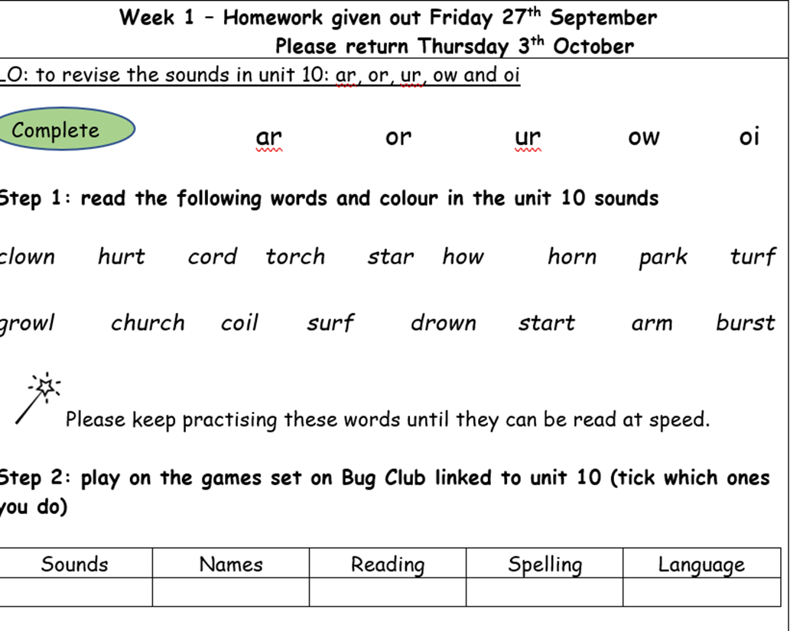
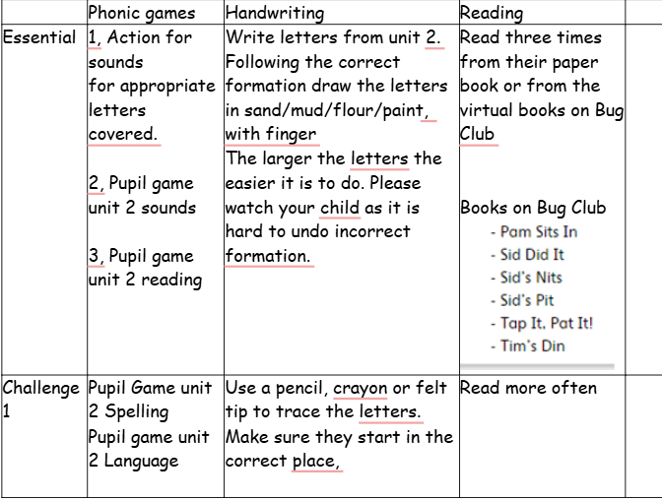
Phonics Homework
Phonics homework will be given to all children on Friday and is to be handed in the following Thursday.

Slide 16
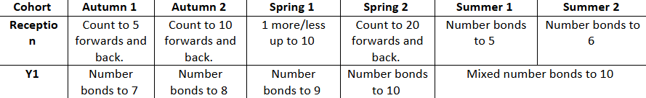
Maths Homework
Again, Maths homework will be given out on Friday and handed back the following Thursday.
The maths homework will be focused on the fluency objective for that term.

Slide 17
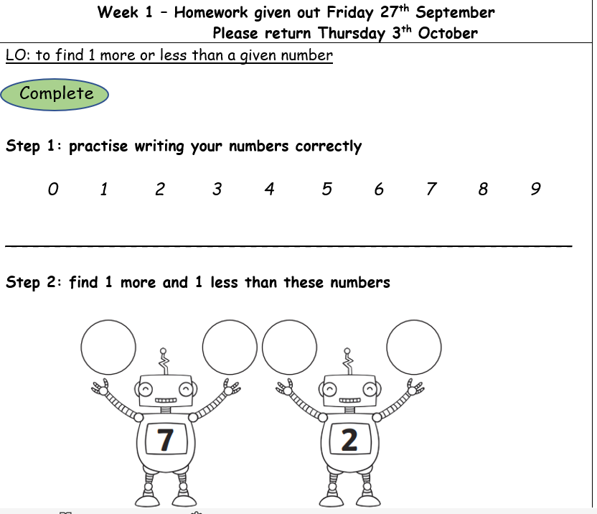
Year 1

Slide 18
When and how we assess
We are constantly assessing children’s understanding through observation throughout all lessons.
We assess phonics after each unit for both cohorts to ensure all children understand sounds.
At the end of each term, you will receive a data letter outlining their progress and attainment.
There will be a parent’s evening each term, however, if you have any concerns regarding your child’s progress, my email is always available.
If I have any concerns in the meantime, I will always speak to you if need be.

Slide 19
Please can the children have a spare set of clothes, which will remain in school. This includes year 1.
This is in case of accidents or any possible spillages.
Please can you ensure that your child's clothes have their name in.
Please can your child always have a waterproof coat that has a hood.
Water bottles need to have names on them and are to be brought in every day.

Slide 20
Thankyou!!
If you want to ask any questions or want clarification on anything, I am here if you want to ask ☺

