Slide 1
KS2 Multiplication Check
Tuesday 10th February 2026

Slide 2
Why?
At the end of Y4, the pupils are assessed on their times tables.
The purpose of the check is to determine whether your child can fluently recall their times tables up to 12, which is essential for future success in mathematics.
It will also help your child’s school to identify if your child may need additional support in Y5.

Slide 3
Why?
We see poor times tables knowledge slowing the children down when
- multiplying and dividing
- working with fractions
- area and volume work
- problem solving
If times tables knowledge is weak, a Y6 child will not reach the end of their SATs test (3 for maths)

Slide 4
What?
An online assessment
25 questions with 6 seconds allowed for each question.
It is expected pupils will get 25 out of 25.
The national average score in 2025 was 21.0 out of 25, 23 for Wincle, with 37% of pupils achieving full marks (25/25), the most common score.
See example on www.timestables.co.uk

Slide 5
When?
The tests will take place in the first two weeks after the May half term.
They will be tested on a 1:1 basis with Mrs Smith and will have completed a practice previously.

Slide 6
How do we prepare?
Lots and lots of times tables practice.
99 Club
www.timestables.co.uk
Identify weaker times tables and focus on those
Blooket club from half term on a Monday lunchtime.

Slide 7
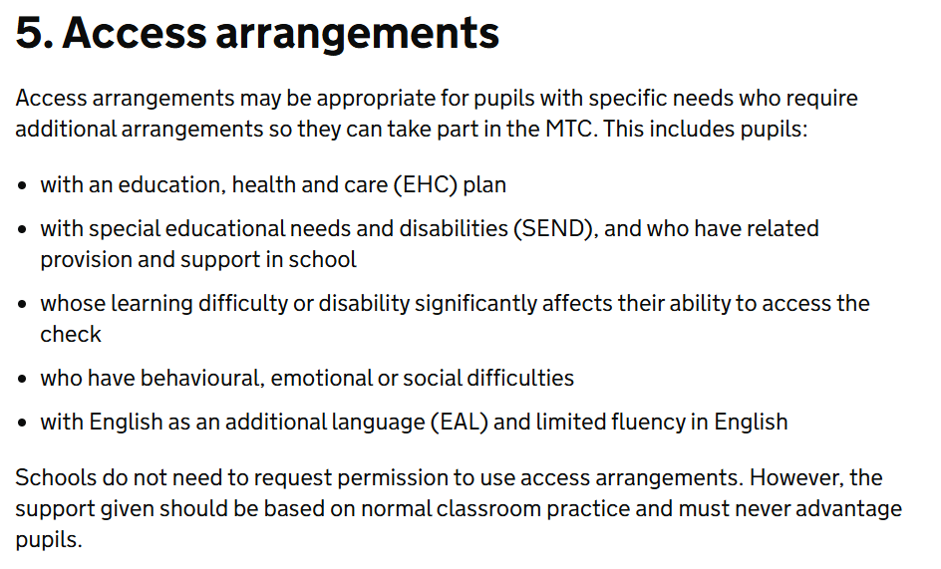
Adjustments

Slide 8
Adjustments
Colour contrast
Font size
Pause – next question button
Input assistanc

Slide 9
Results
The pupils do not see their results immediately after completing the questions.
The school can download the results from 23rd June.

Slide 10
Any Questions?

