Slide 1

Supporting Your Child:
Preparing for Secondary School Transition
Transition Lead – Rachael Pickles rachael.pickles2@cheshireeast.gov.uk

Slide 2
Welcome & Introduction
Purpose of the session:
Why transition Matters
What to expect – the admissions process
Explain common challenges during transitions
Share practical strategies for parents
Specific Q&A time

Slide 3
What is Transition
Transitions means a change from one thing to another
Types of Transition in schools:
Class to Class: New teacher, new peers, different routines
Key Stage to Key Stage: Increased independence, curriculum changes
Primary to Secondary: Larger setting, multiple teachers, more responsibility

Slide 4
Why does is Matter?
Transition can be exciting but also challenging
Changes in environment, expectations and routines can cause apprehension
Children with additional needs or SEND may need extra support to manage change
A smooth transition can improve confidence, wellbeing, and academic success

Slide 5
The Transition Process to Secondary School
Start planning as early as possible
Begin more formal discussions in Year 5 and Year 6
Early visits and conversations with potential next settings can help reduce anxiety – there are no age restrictions for attending open days.
If your child has an EHCP then the Annual Review in Year 5 is key to planning, ideally held in the spring term – this should be a starting point for transition planning and exploring options. Invite potential next settings in the Yr5/6 EHCP review.

Slide 6
General Admissions for school places open via the parent portal in September of Year 6 and closes in October – secondary school place offers are made in March. Allocations are based on school set criteria.
For those children with an EHCP the SEND team will support with the transition process and families will be contacted by the SEND team directly at the end of Yr 5/beginning of Yr 6. You do not need to register via the general admissions parent portal. The deadline for naming secondary transitions for EHCPs is February 15th

Slide 7
Common Worries and Challenges
Anxiety about change
School being bigger
Friendship – new and old
Managing new routines and expectations
Academic adjustments
Homework

Slide 8
Strategies for Parents
Communication: Talk positively about change
Routine: Keep home routines consistent. Start to plan the new routine
Preparation: Welcome letters, photos/maps and visiting new classrooms/schools
Independence: Encourage small responsibilities at home
Social Skills and Confidence: Arrange playdates or meet-ups with peers
Emotional Support: Ask open questions when talking about emotions and start to use calming techniques at home

Slide 9

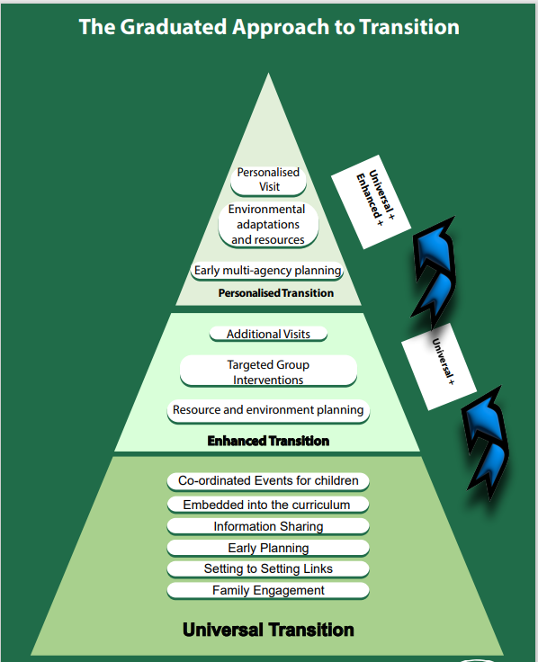
Resources for Parents
School websites – specific information about their provision
Live Well – Family Hubs for our local offer support.
  Togetherness – Sollihull Approach free online learning for parents
Live well School transitions – support for parents and professional transition guides
Local authority SEND support – EP drop in
              SEND Local Offer
Kooth – online, anonymous counselling service. 10-25

Slide 10
Questions?

